Slide 1
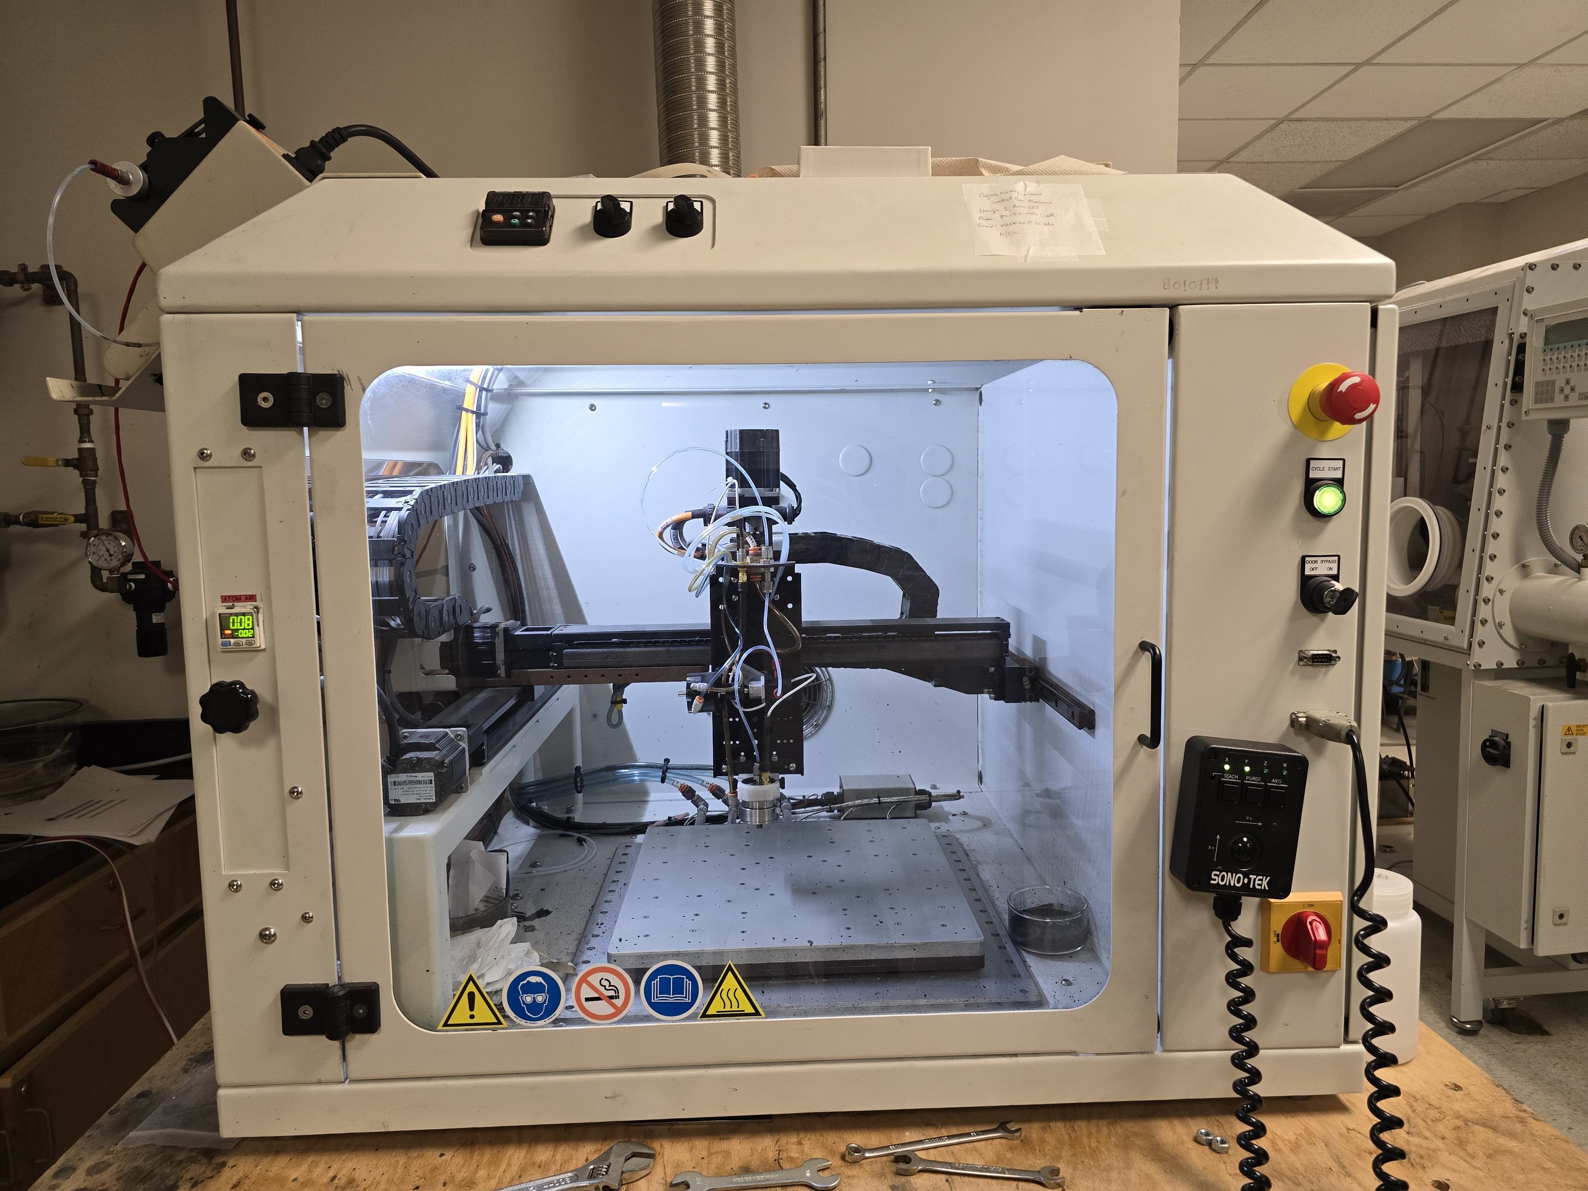
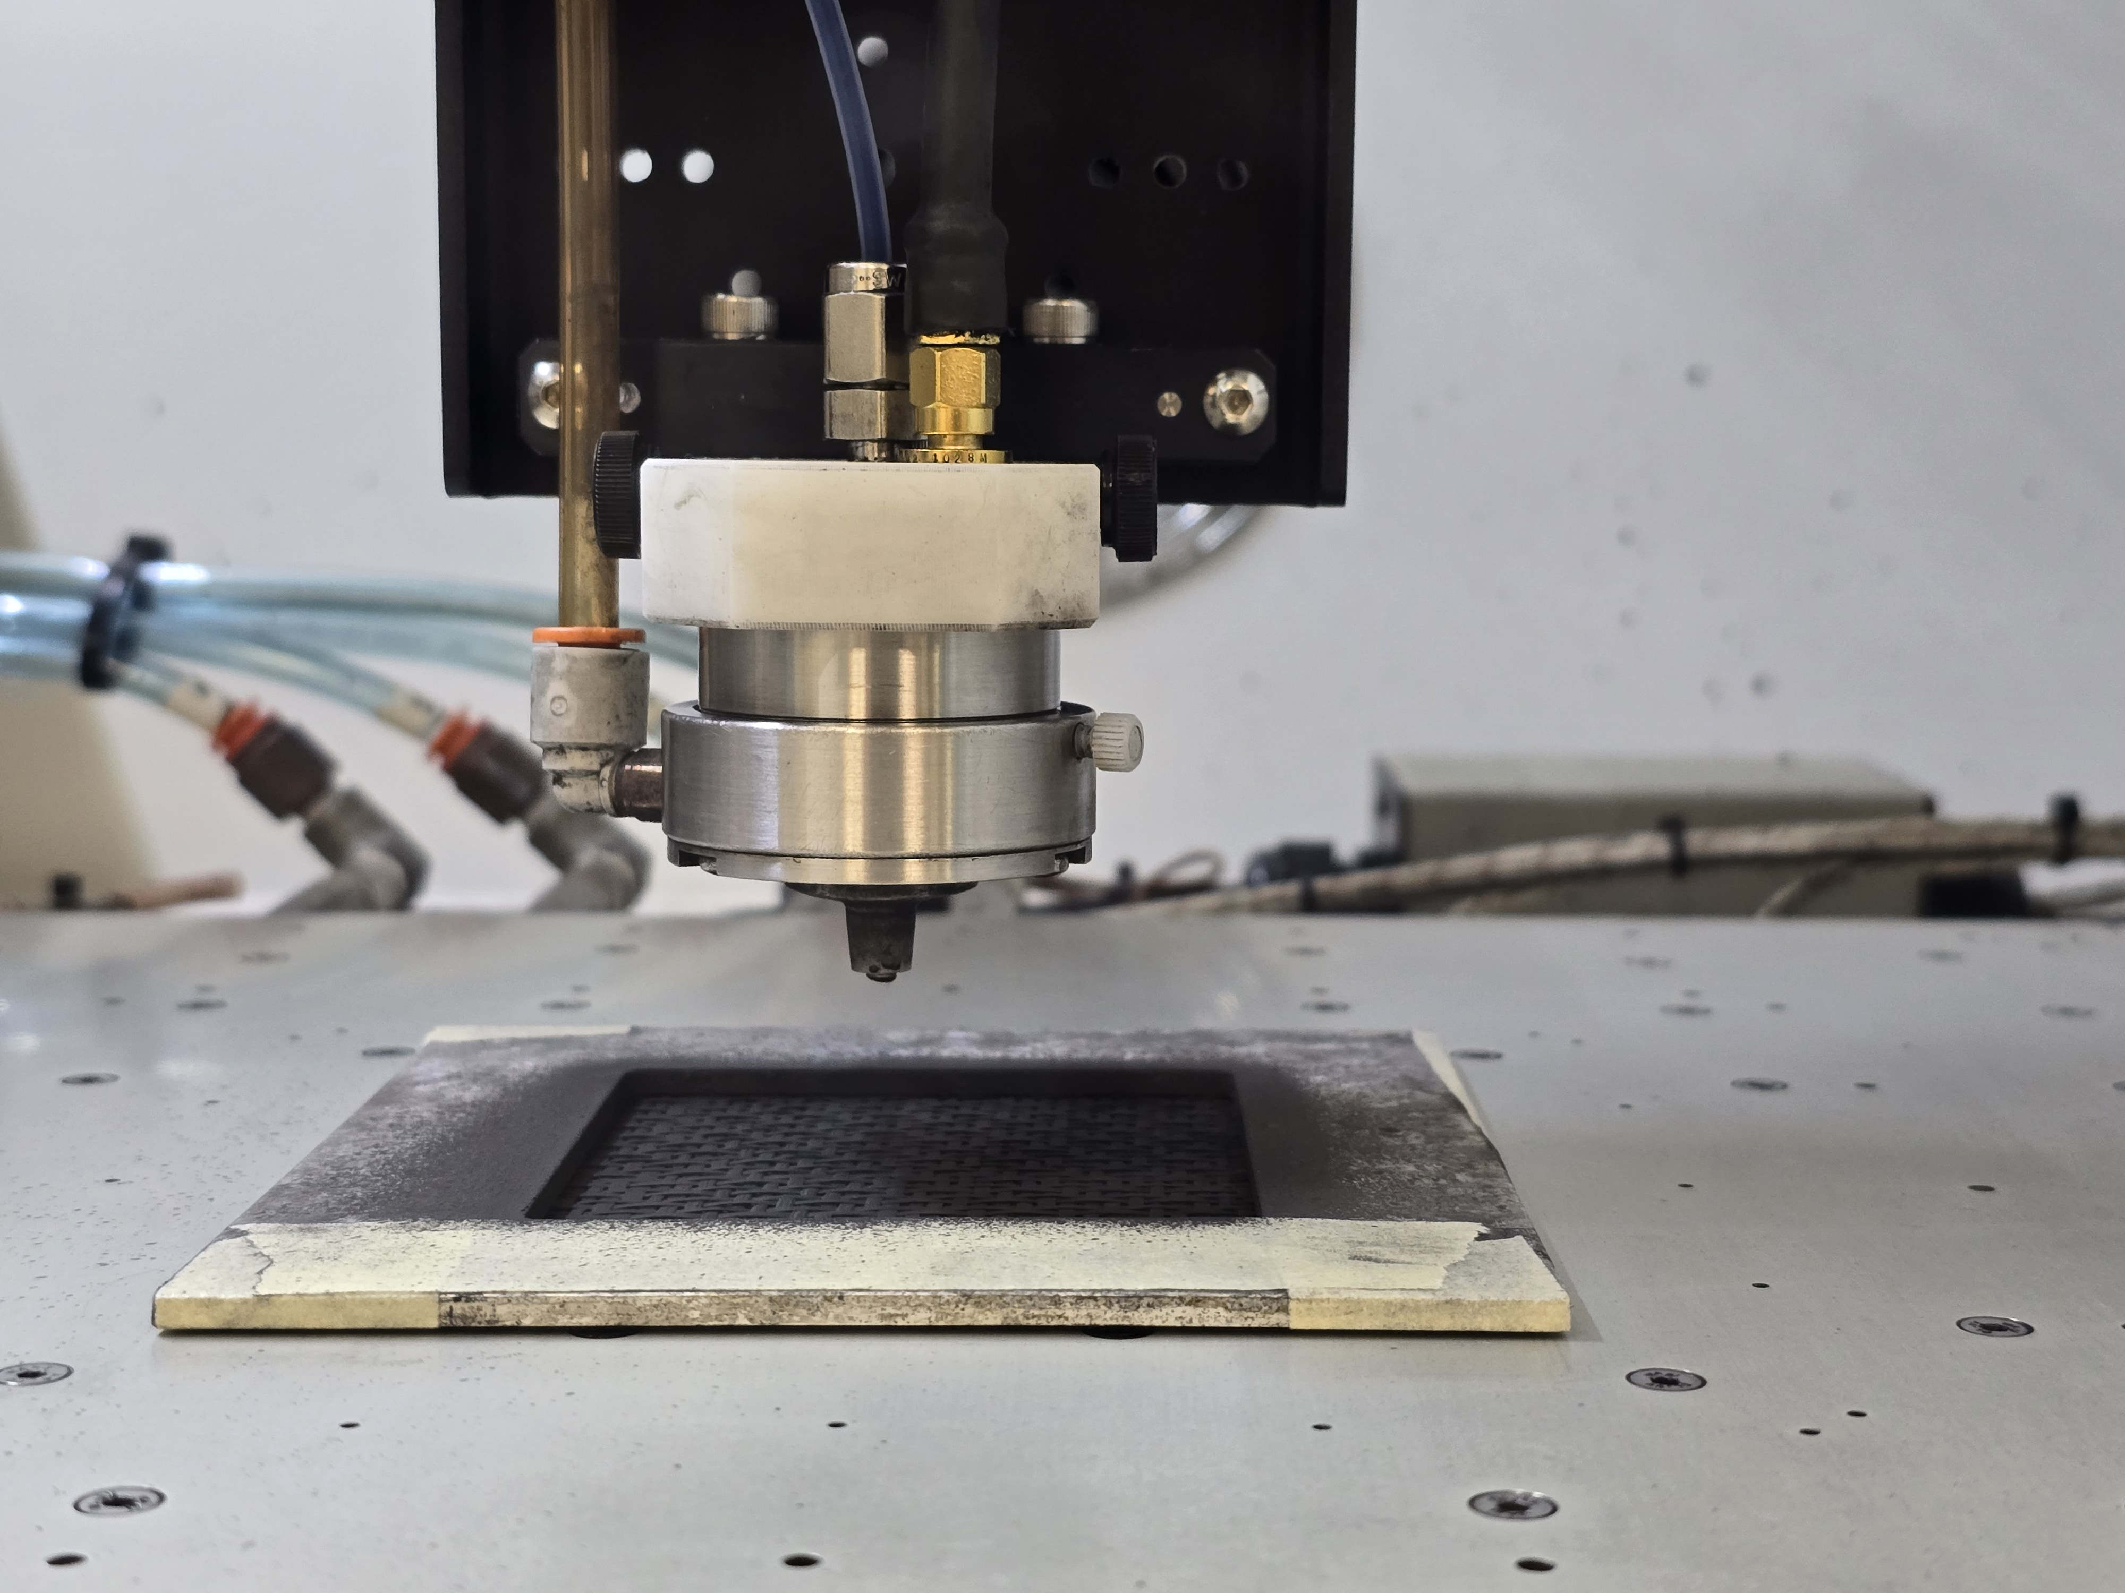
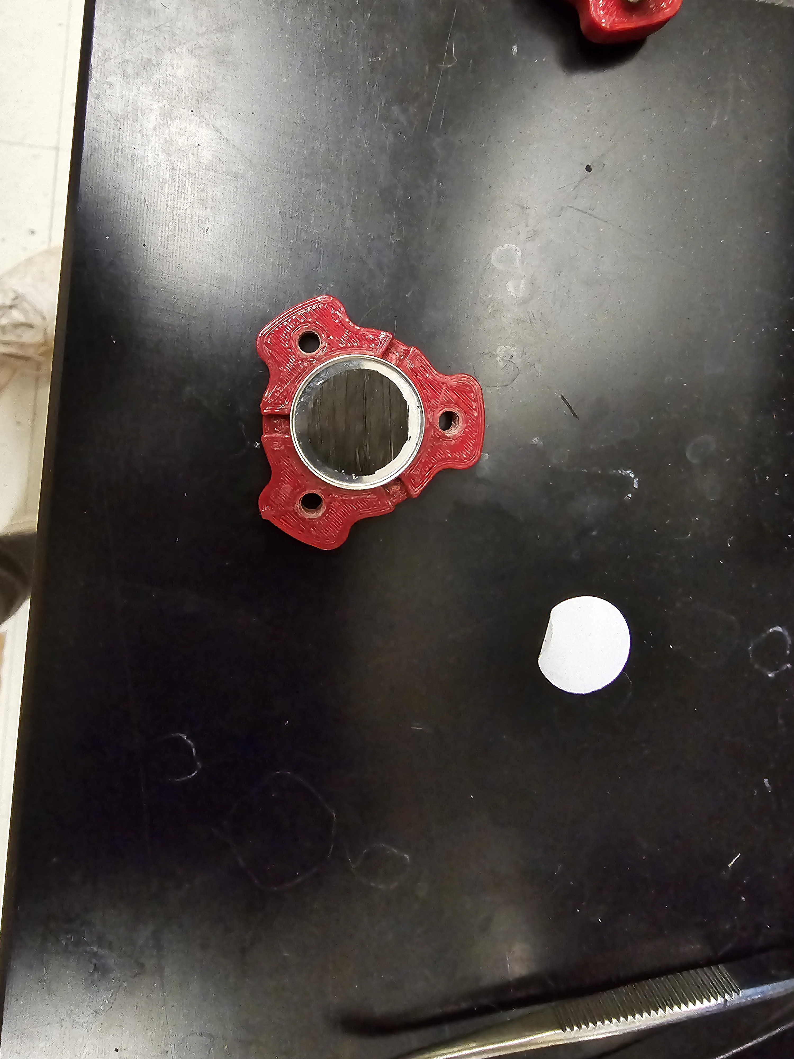
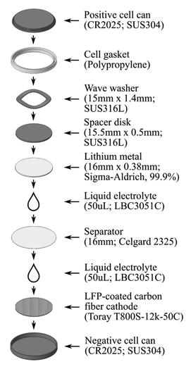
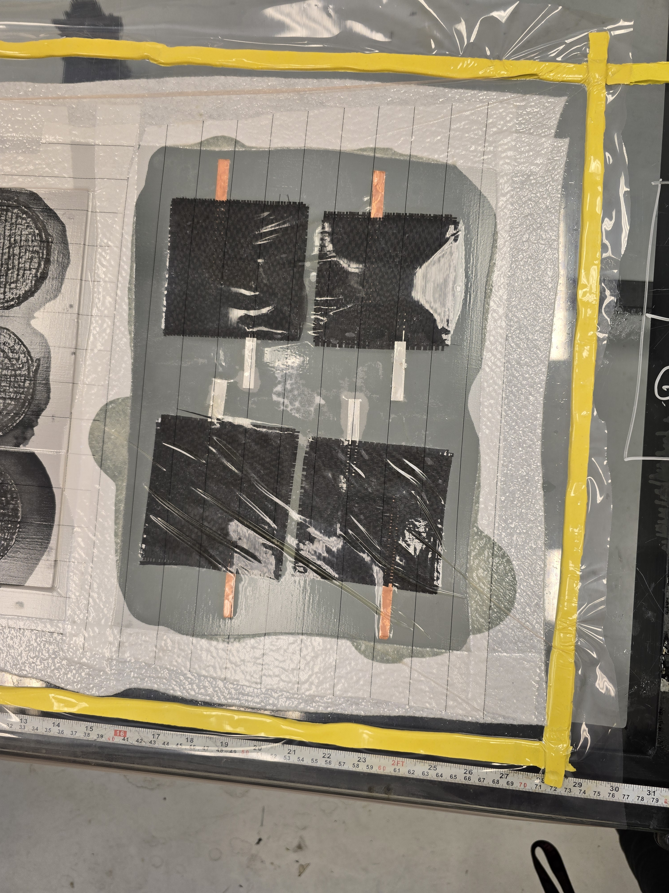
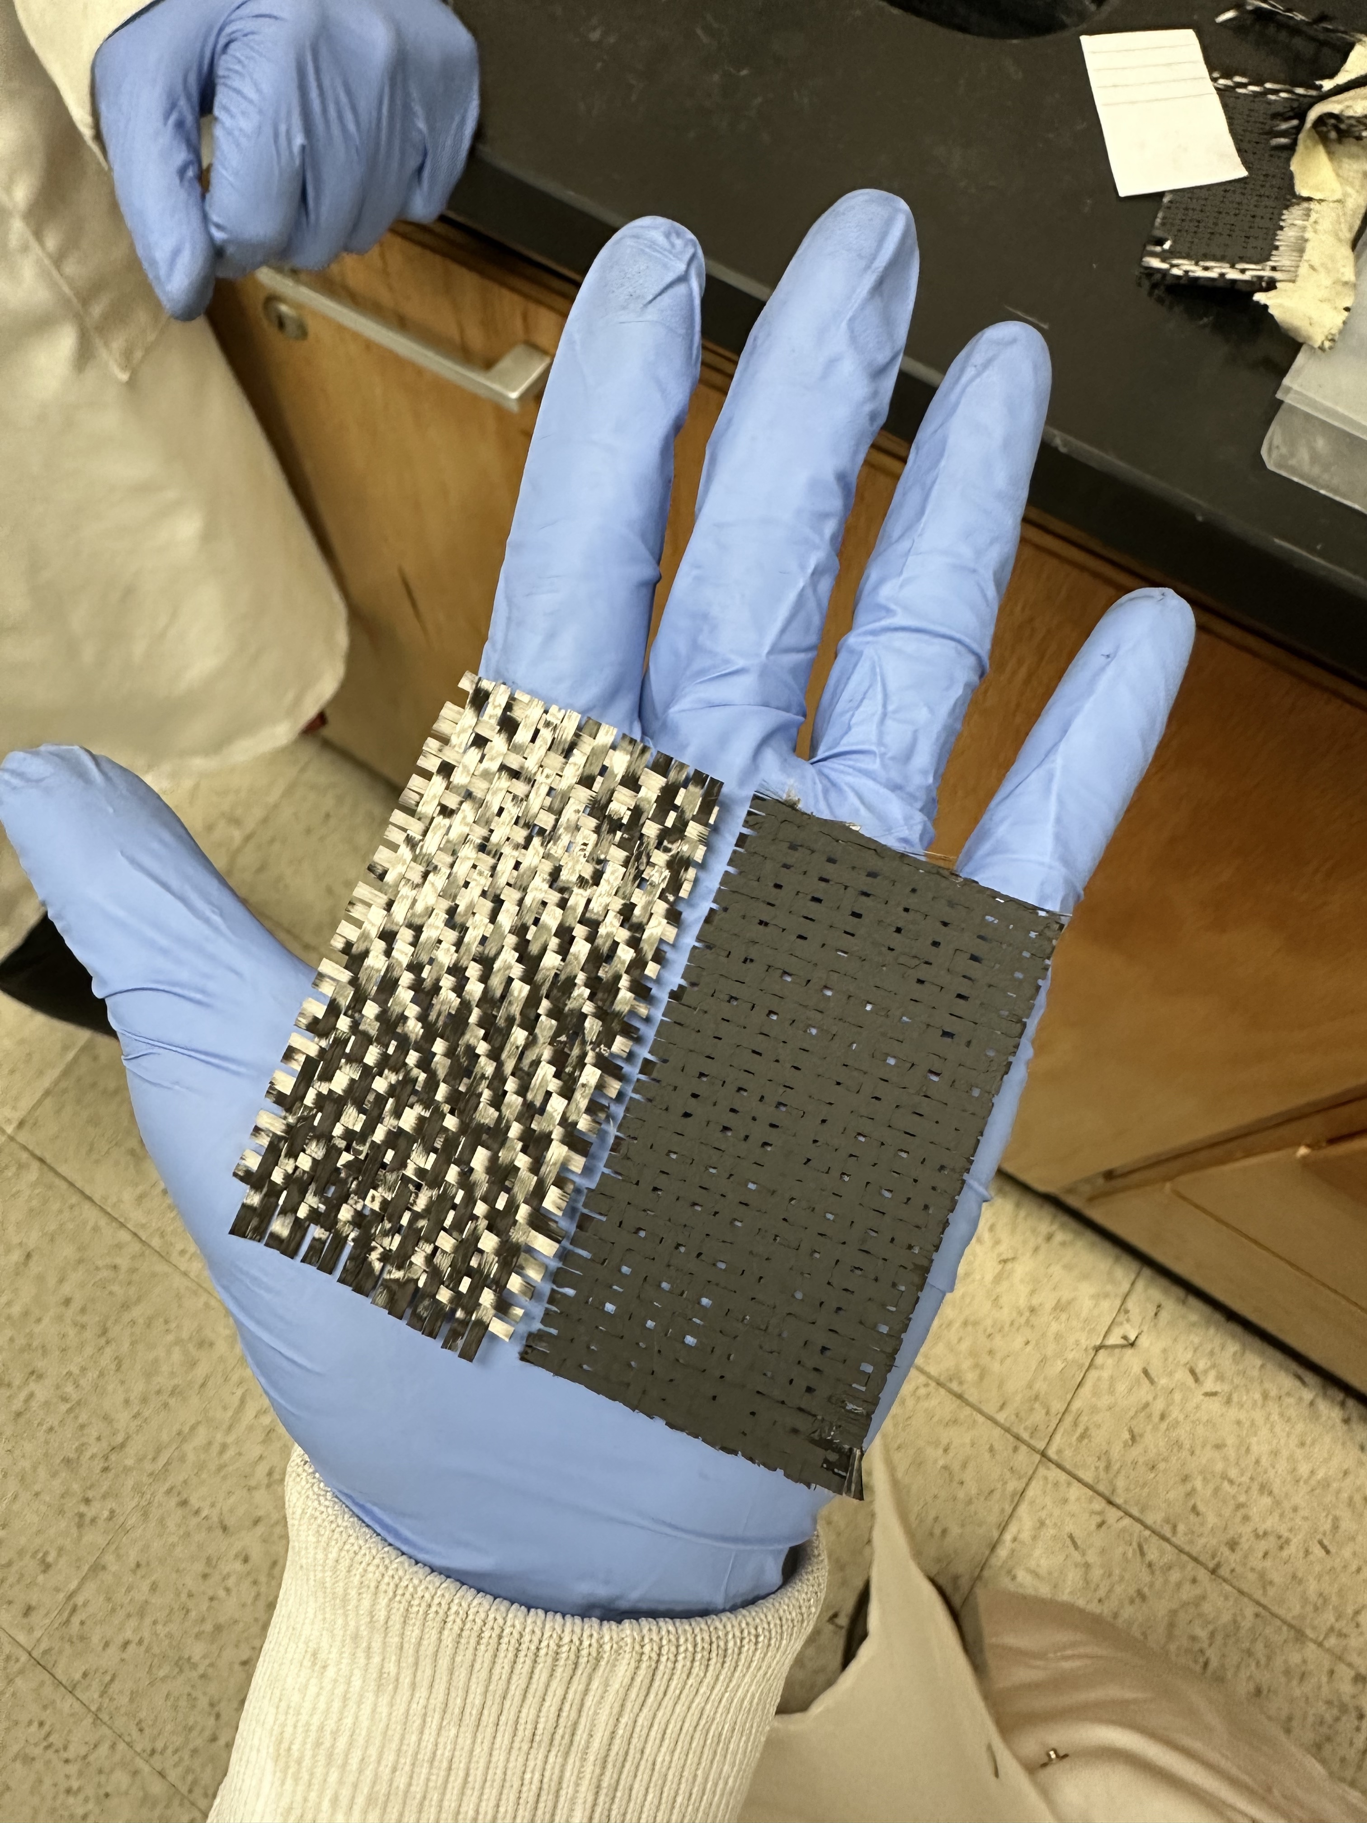
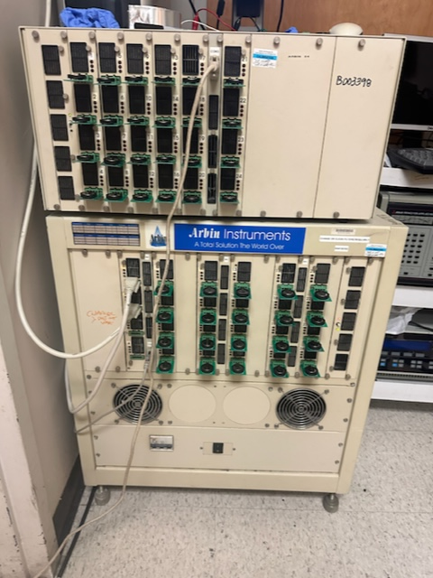
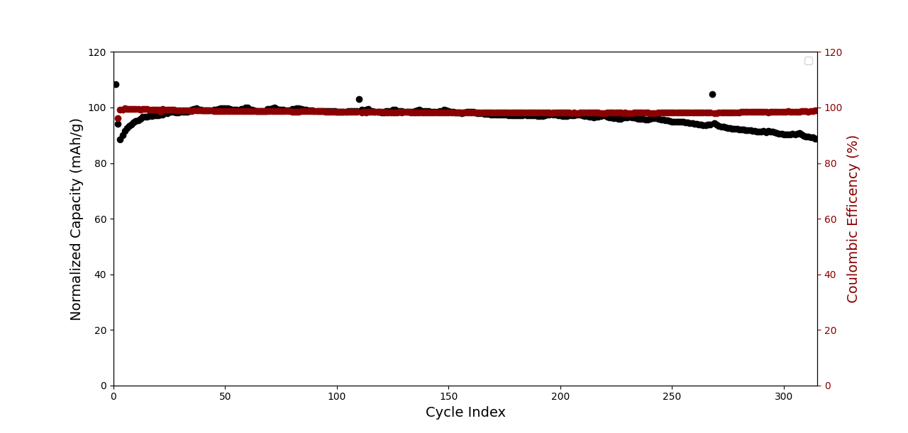
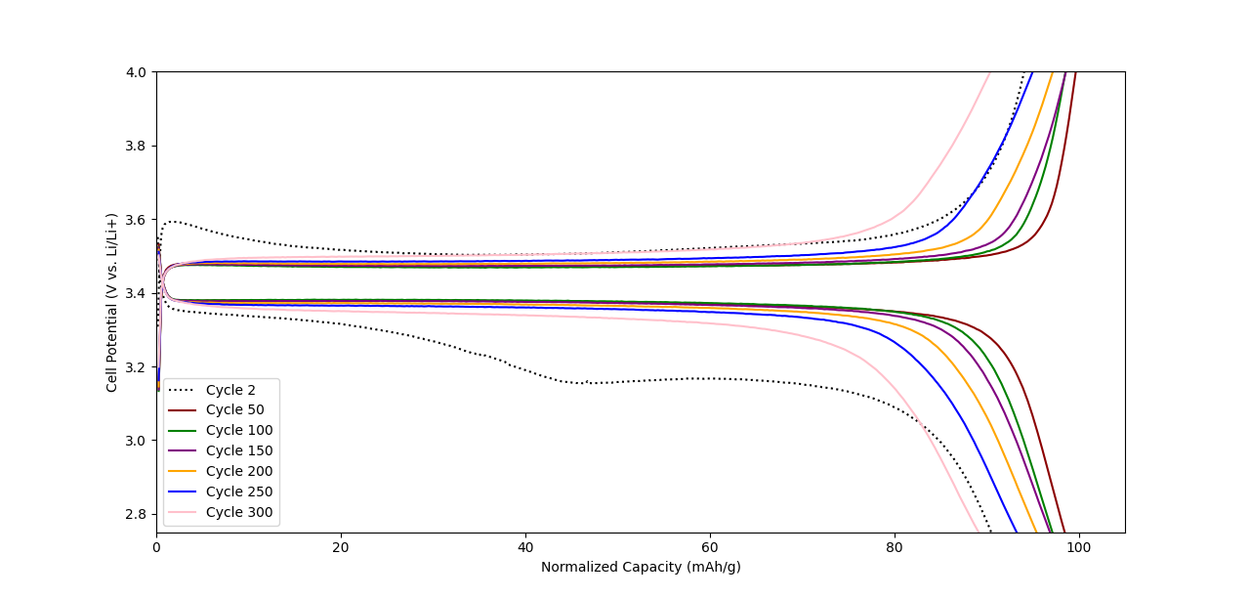
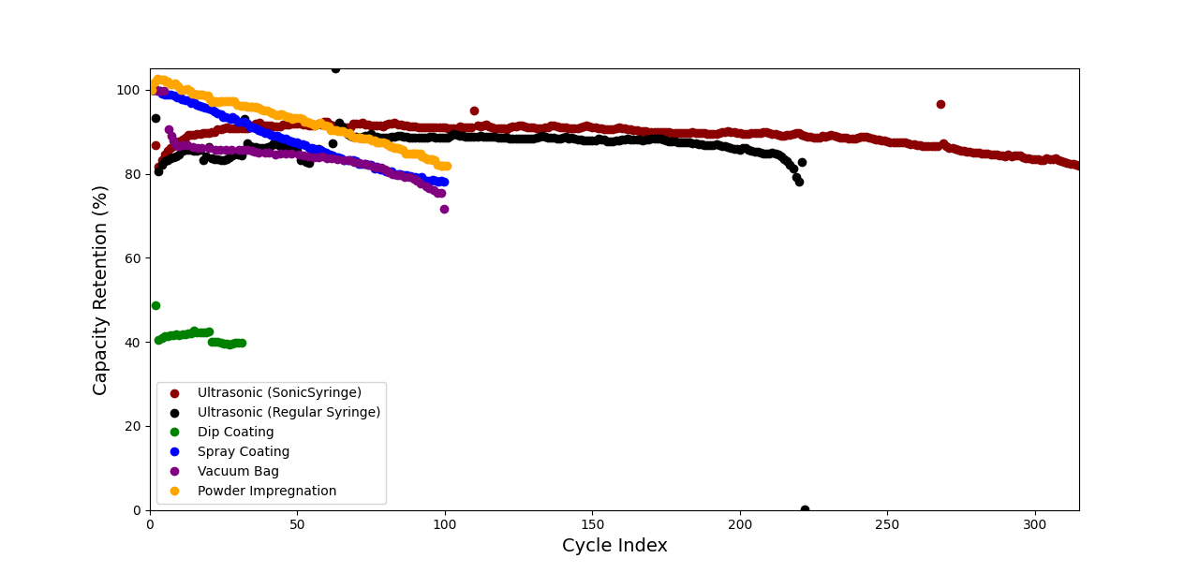
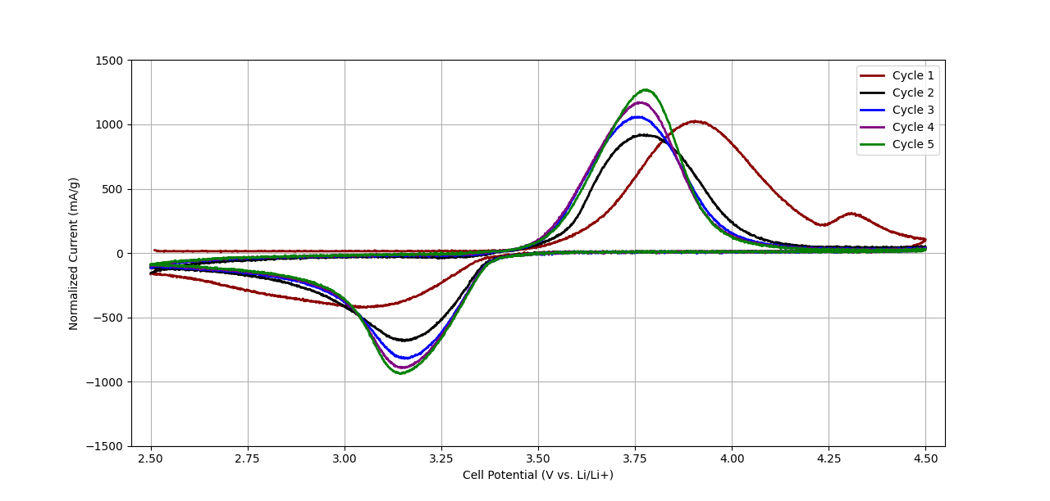
Research Poster Template
Ultrasonic Spray Coating to Form Composite Cathodes
Connor Burns & Liliana DeLatte
University of South Carolina, College of Engineering and Computing
Introduction
Coating Process
Li-Ion batteries are at the forefront of electrochemical research; providing excellent energy density capable of powering large vehicles. Major issues with the use of these batteries are their massive size and cost. A leading solution are structural batteries which utilize carbon fiber's ability to store electrical energy, allowing for the creation of batteries that serve as structural parts for a vehicle. A goal in the production of structural batteries is an effective method for coating carbon fiber with active material to help reduce cost and material waste. This study explores advantages of using Ultrasonic spray coating to produce effective structural cathodes with minimal loss of active material.
Objectives
Optimize Ultrasonic spray coating
Determine the electrochemical performance of the coating
Compare the physical properties of the Ultrasonic spray coating to other methods of coating
Investigate the interactions between the Ultrasonic spray coating and a hybrid polymer electrolyte
Figure 1. Coin cell construction as depicted by Petrushenko et al.
Results
Conclusion
Using the Sono-TEK Exactacoat machine, we optimized surface coatings on carbon fiber tows. This technique of spraying can be used to coat active material onto carbon fibers, creating a functional cathode. Our results have been significant, and a publication is planned under the guidance of Dr. Ralph E. White and Dr. Paul T. Coman.
Figure 4. Capacity drop and coulombic efficiency over 315 cycles.
Figure 5. Capacity loss across 300 cycles as a function of voltage.
Figure 2. The surface of ultrasonically coated carbon fiber.
Acknowledgements
1. D. Petrushenko et al., Energy and Fuels, 37, 711–723 (2023) https://pubs.acs.org/doi/10.1021/acs.energyfuels.2c03210.
2. J. Choi, O. Zabihi, M. Ahmadi, and M. Naebe, RSC Adv., 13, 30633–30642 (2023).
3. Y. D. Yücel et al., Compos. Sci. Technol., 241 (2023).
4. Y. D. Yücel, D. Zenkert, R. W. Lindström, and G. Lindbergh, Electrochem. commun., 160 (2024).
Figure 7. Capacity retention comparison between other coating methods found in literature^{2,3,4}.
Figure 3. A cross-sectional view of an ultrasonically coated carbon fiber tow
Figure 6. Cyclic voltammetry at a sweep rate of 0.001 V/s between 2.5 and 4.5 V.

