Slide 1


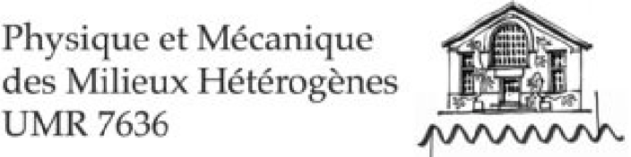



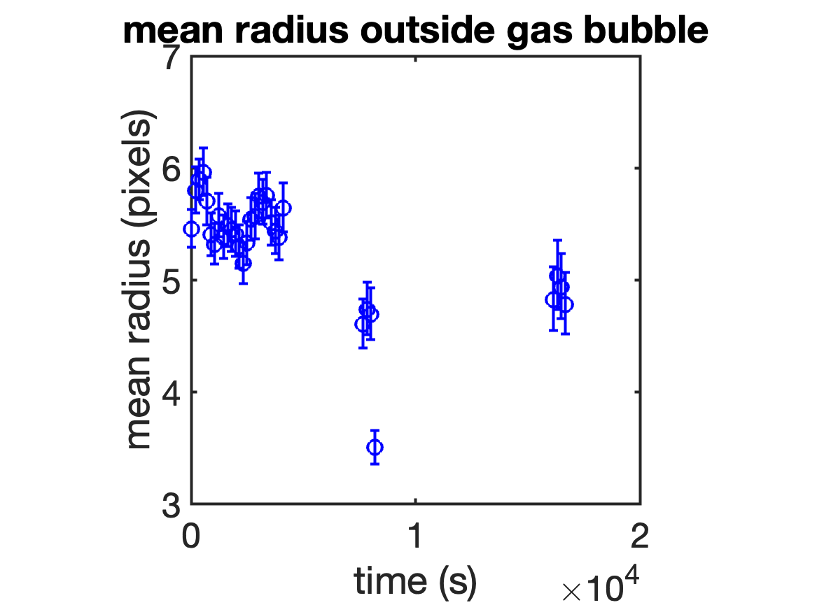
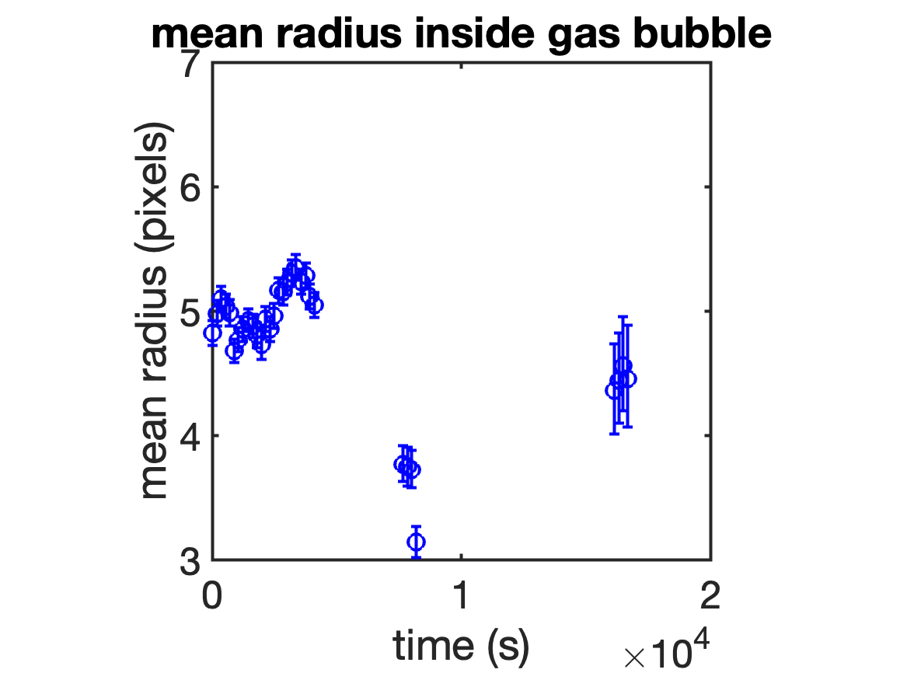
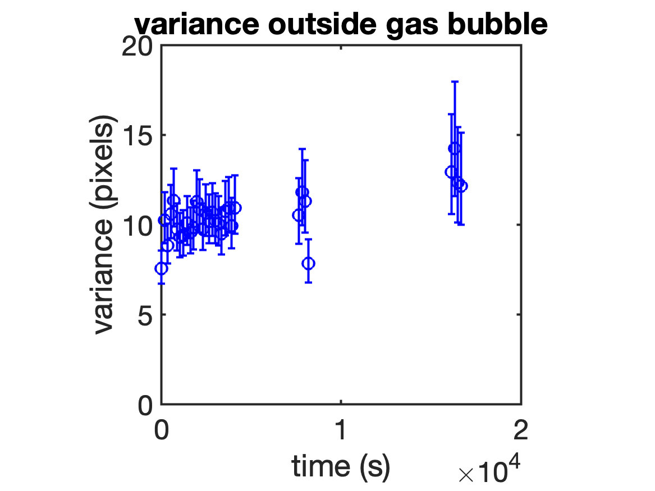
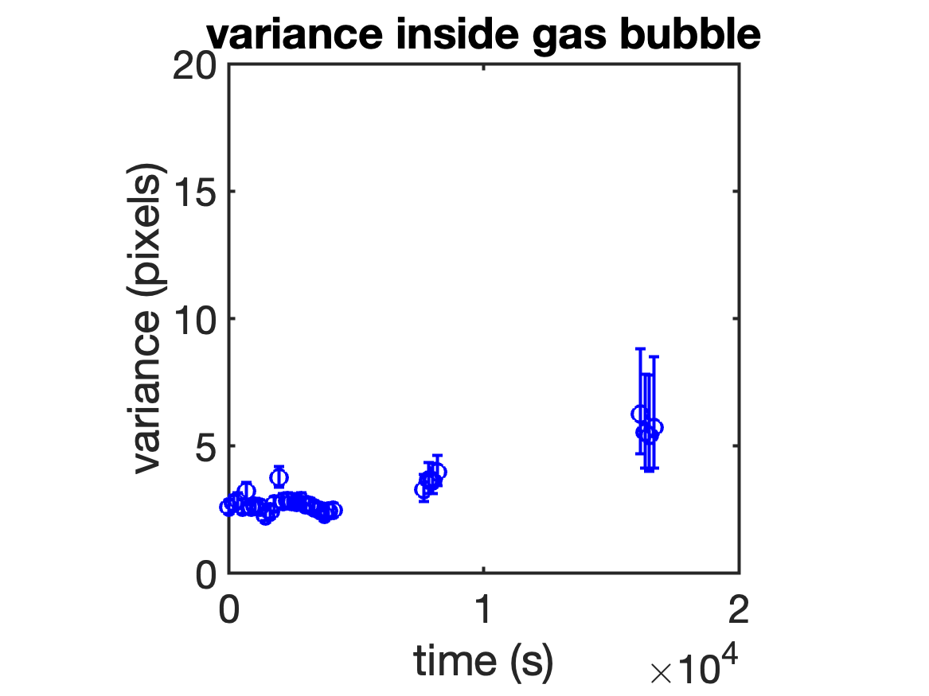
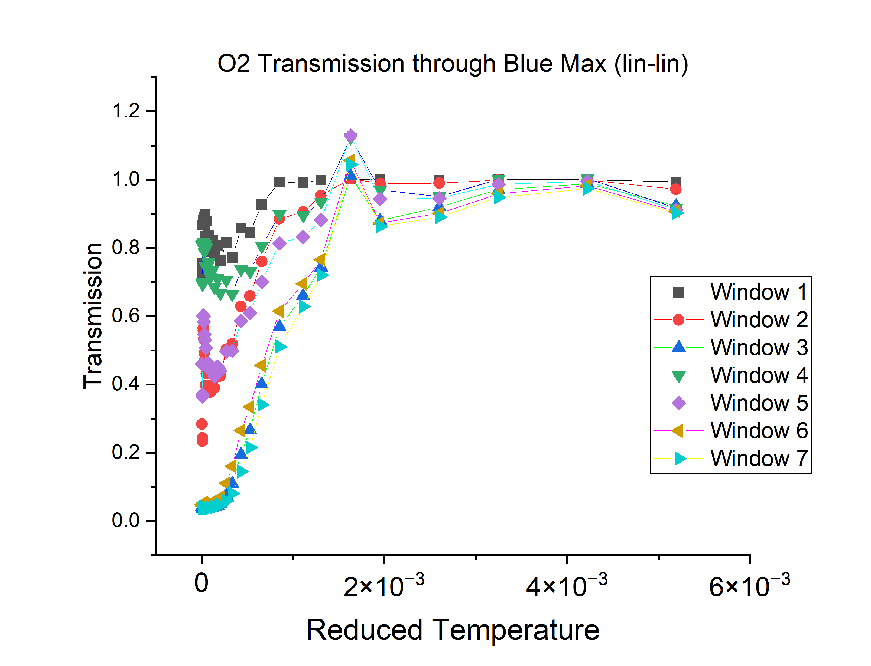
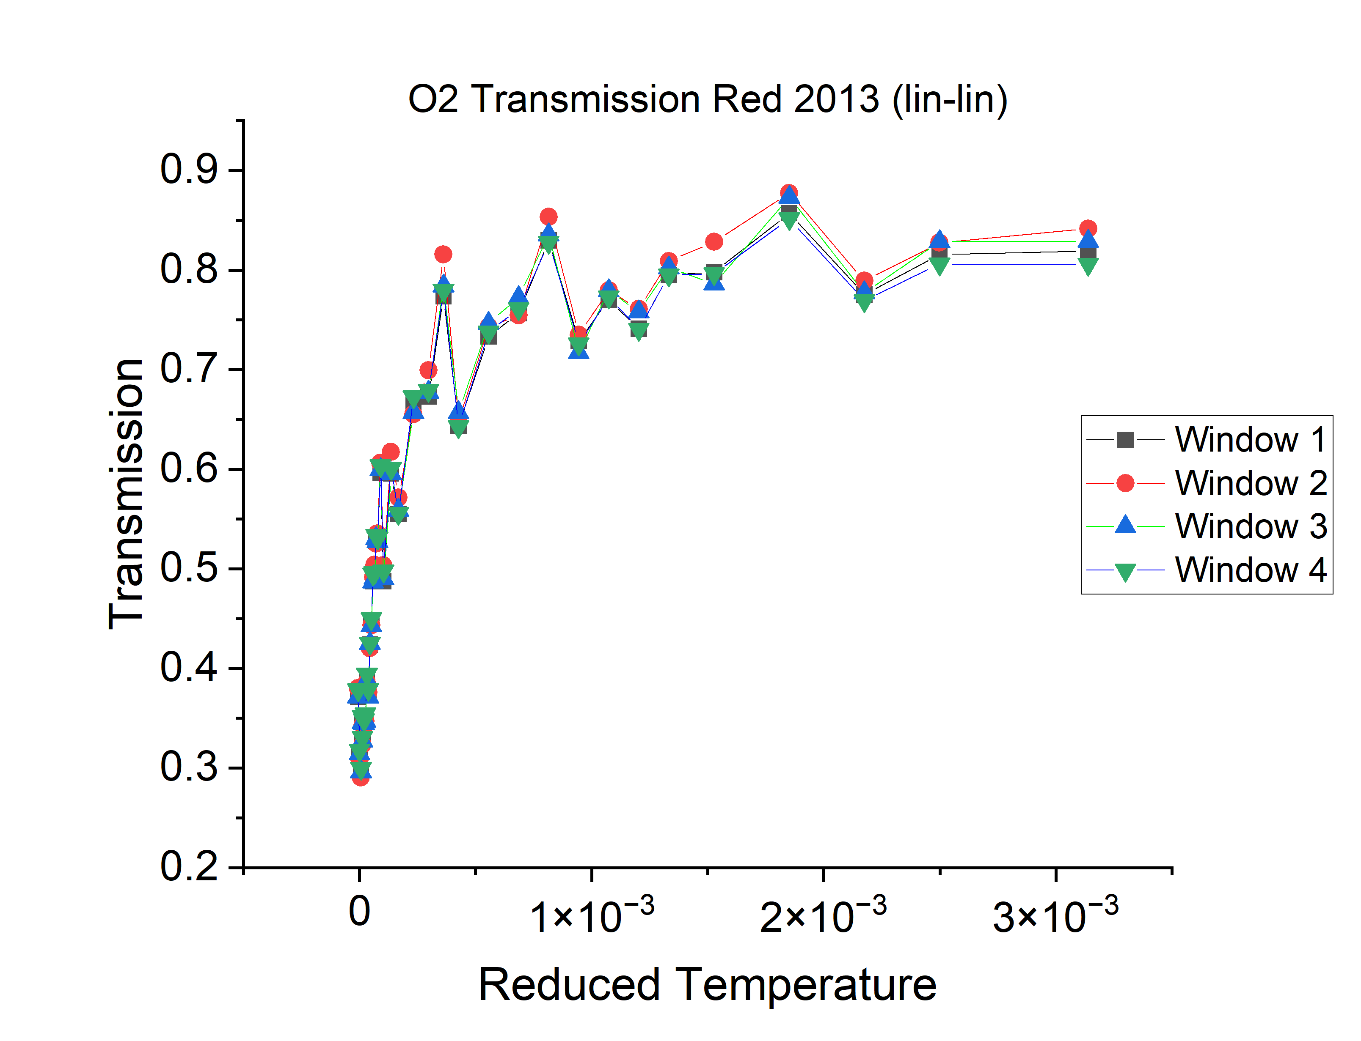
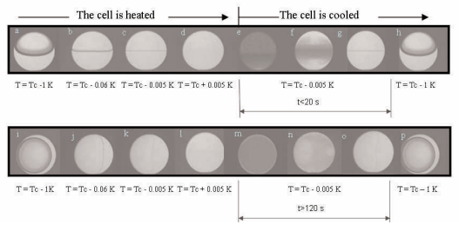
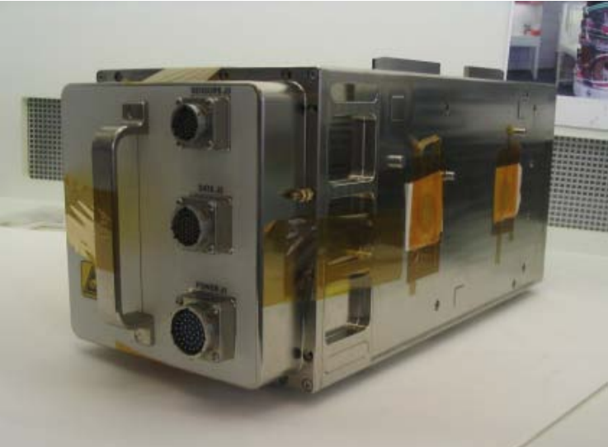
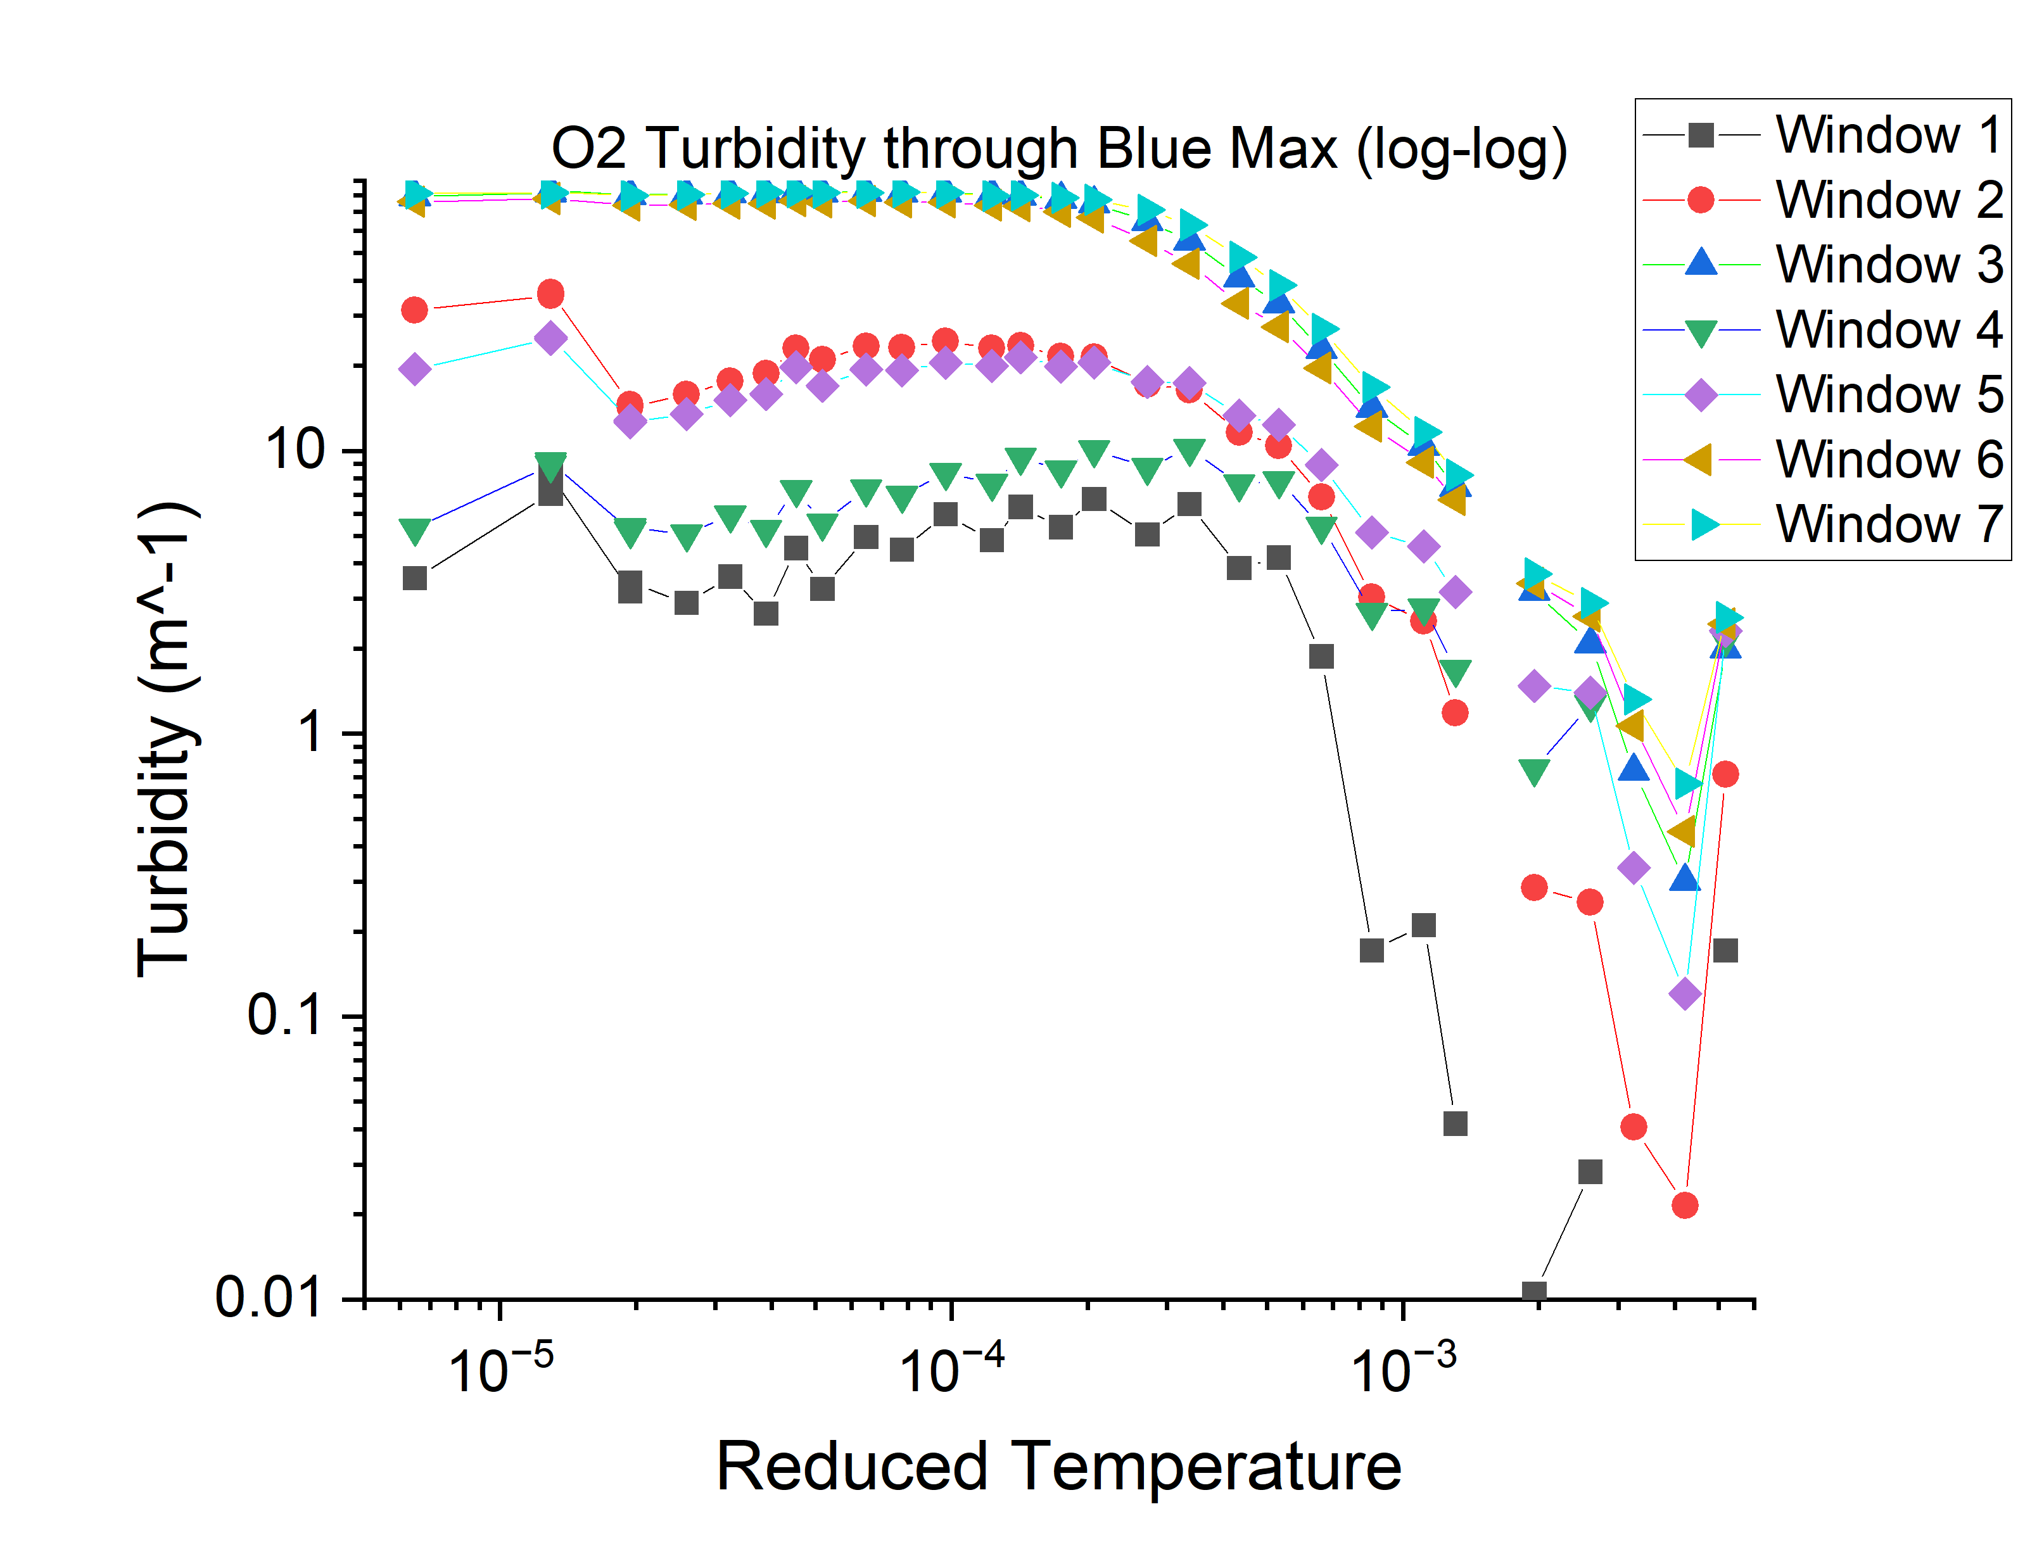
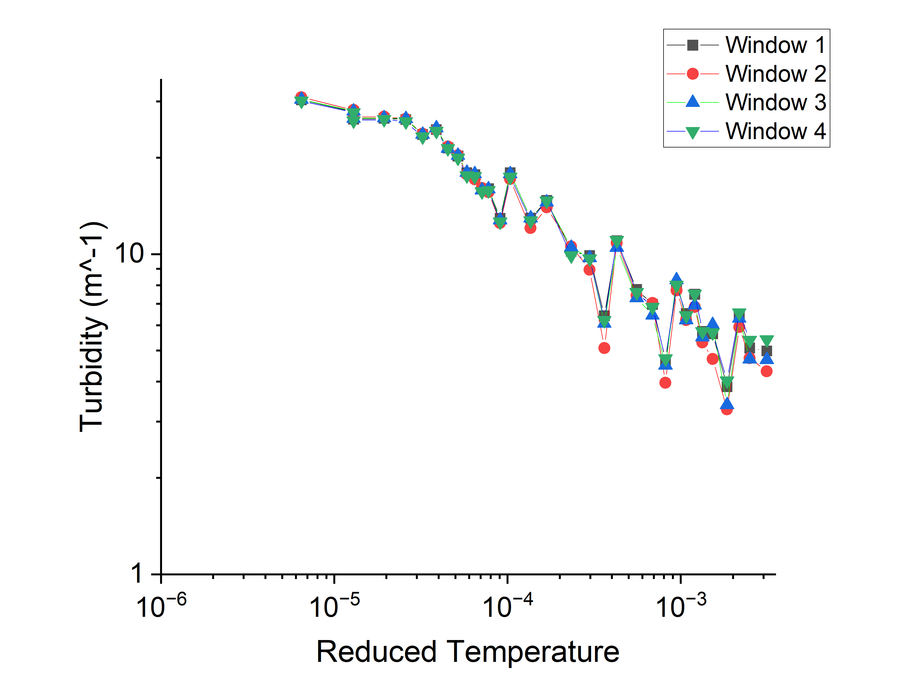
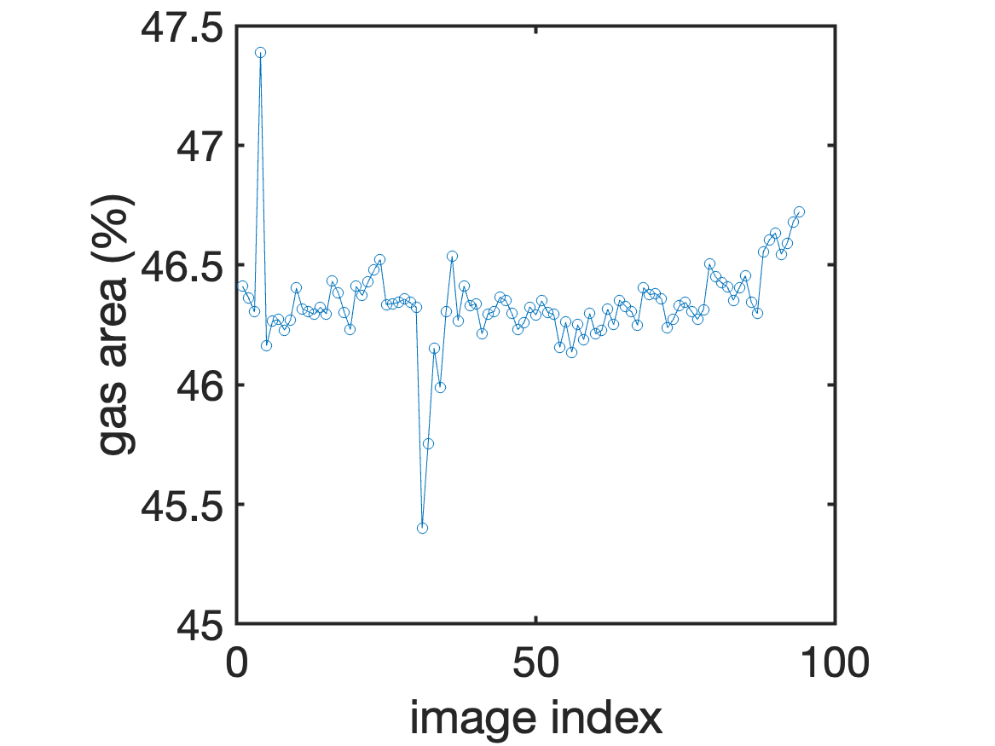
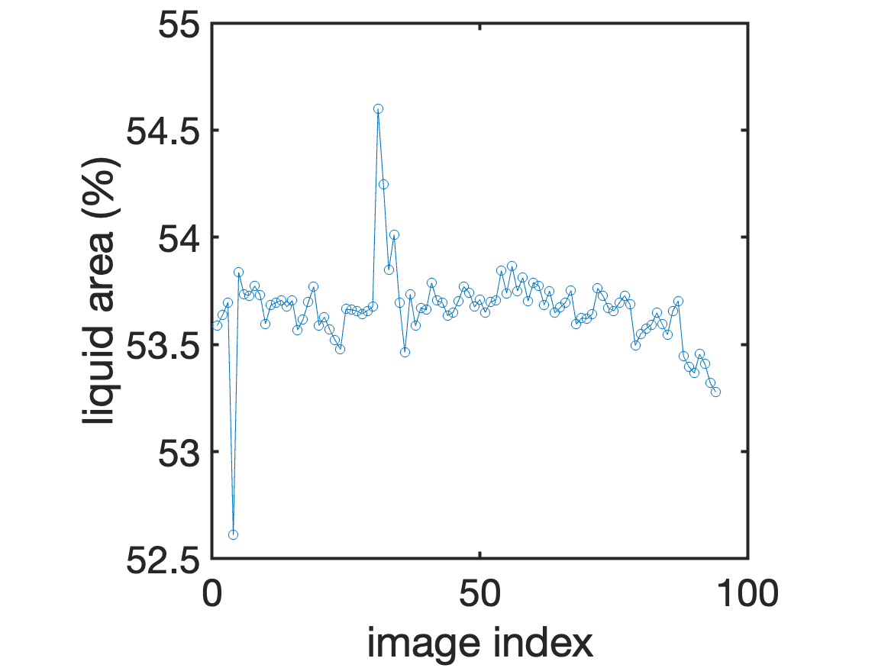
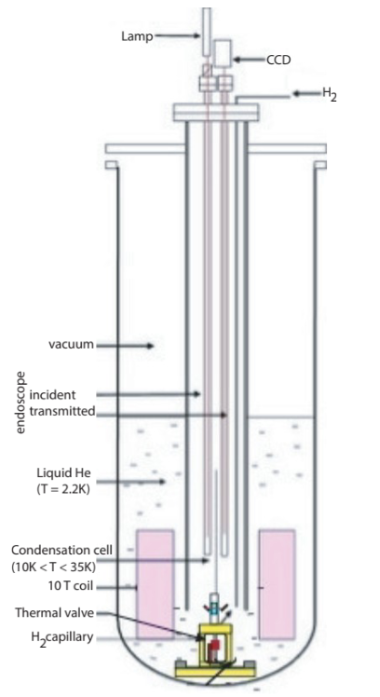
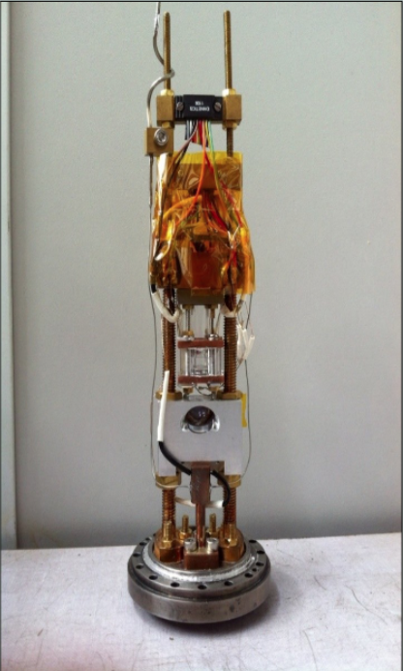
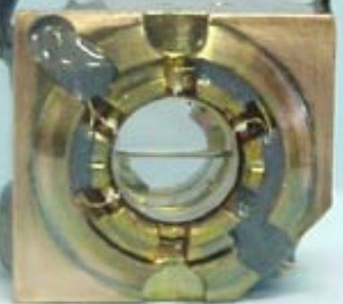
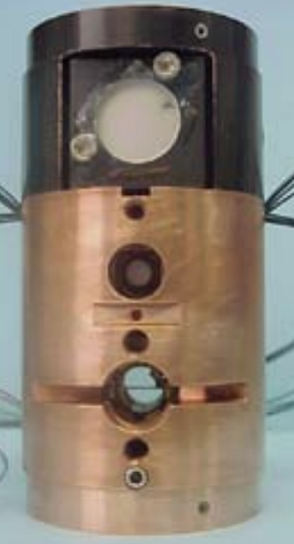
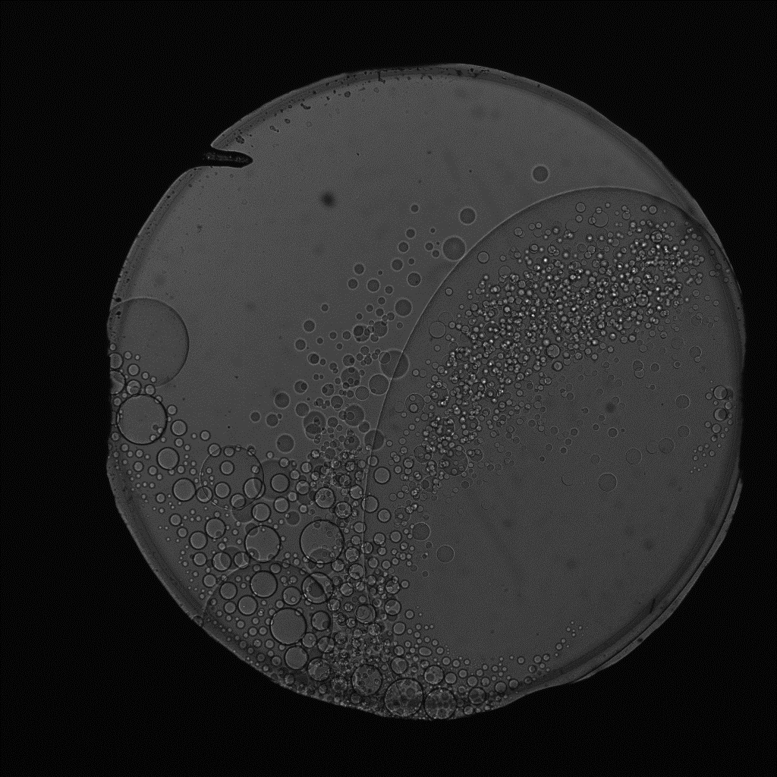
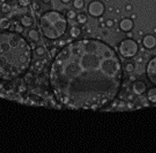
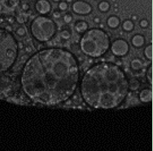

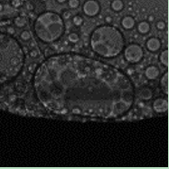

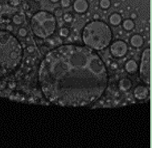

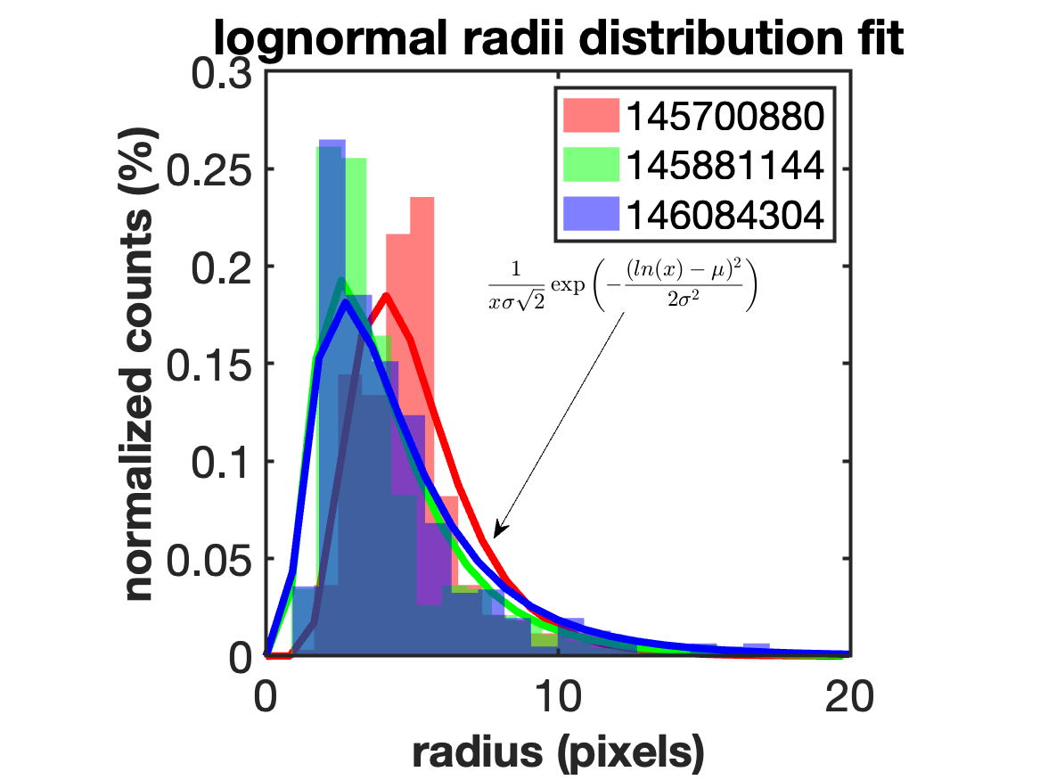
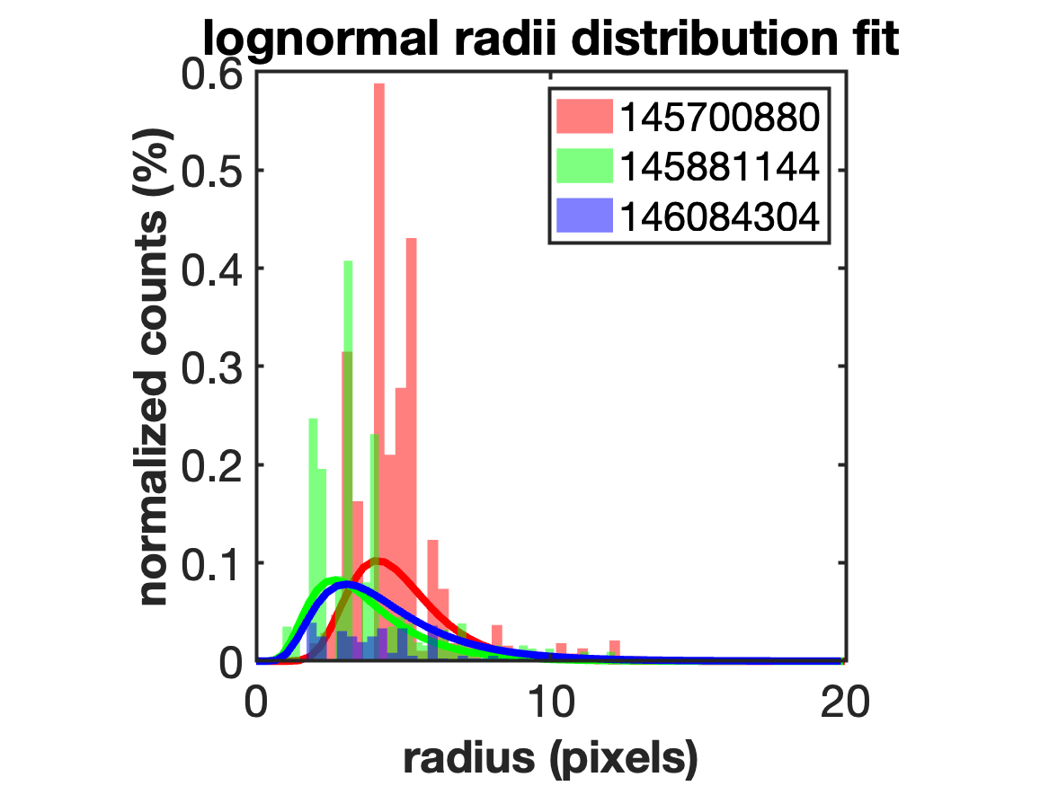




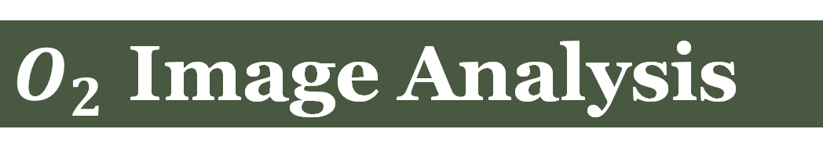
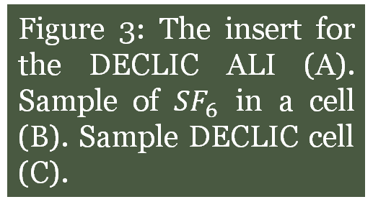
Universality Laws in Pure fluids and Critical point Experiments under Density Gradients
Ella Muschlitz¹, Ana Oprisan¹, Yves Garrabos² Carole Lecoutre², Gurunath Gandikota³, Denis Chatain³, Daniel Beysens⁴
¹Department of Physics and Astronomy, College of Charleston; ²University of Bordeaux, ICMCB; ³SBT, UMR-E CEA/UJF-Grenoble 1, INAC; ⁴Laboratoire de Physique et Mécanique des Milieux Hétérogènes, UMR 7636 CNRS-ESPCI Paris, PSL Research University
As a fluid containing a liquid and a gas approaches its critical point, by either heating or cooling, that fluid becomes homogeneous. The fluid and the gas become indistinguishable. Simultaneously, the fluid becomes opaque, turbid, and has a low transmittance. While approaching the critical point, some of the parameters in the fluid begin to behave differently and diverge asymptotically. One notable change is the isothermal compressibility. Approaching the critical point causes the fluid to be more sensitive to the effects of gravity. As a result, the behavior of the fluid changes while in a low gravity environment and subjected to large accelerations. Therefore, the study of critical fluids is needed to further space exploration with NASA.
This experiment has two major parts, the first involving oxygen and the second involving sulfur hexafluoride. For the oxygen data, test cells were placed in the HYLDE’s magnetic field to simulate low-gravity. The purpose of this data was to analyze the universal critical exponents, isothermal compressibility $K_{T}$ and correlation length ξ. Using a CCD camera, red, green, and blue light was shined through the cell during temperature quenches to measure transmission and the calculate turbidity. Using the equations,
$T=\frac{I_{T}}{I_{0}}$ $τ=−\frac{1}{e}ln⁡(\frac{I_{T}}{I_{0}})$
The calculated transmission (1) was used to calculate experimental turbidity (2) and using equation (3) we find critical exponents, isothermal compressibility, and correlation length.
$$τ=AT_{c}\left(1+ε\right)k_{T0}ε^{−1.24}F\left(a\right)+τ_{B}$$
For sulfur hexafluoride, the coalescence of bubbles/droplets after a 0.2 mK temperature quench was studied. Using the software iSolve, each vapor or gas bubble could be measured. These measurements were compared to time from the original critical temperature quench.
$O_{2}$ Image Analysis
Introduction
(A) (B)
(C) (D)
(E) (F)
(A) (B)
(C) (D)
(A) (B)
Figure 4: Images (A), 2015, and (B), 2013, are taken at 154.922 K of the blue and red light maximums respectively. Image A shows the outlines of the seven windows used to collect data. Image B shows the outlines of four windows used to collect data.
Experimental Design
(A)
Figure 5: Images (C) and (D) are the transmissions of each color and different data sets, respectively, as shown in Figure 4. These graphs are on a lin-lin scale.
Figure 9: Figure 9: A graph of the mean radius of the bubbles in the liquid structure as a function of time (A) and the mean radius of the droplets inside the gas structure (B). A graph of the variance in the liquid structure as a function of time (C) and the variance inside the gas structure (D).
Figure 1: A data set comparing critical fluid experiments in gravity (top) and in a low gravity environment (bottom) (A).
(A)
(B)
(C)
Fluid-filled cell
Figure 3: The insert for the DECLIC ALI (A). Sample of ${SF}_{6}$ in a cell (B). Sample DECLIC cell (C).
Figure 6: Images (E) and (F) show the experimental turbidity for each color (different data sets), respectively on a log-log scale. Each line represents a different window.
Fitting directly imaged turbidity data can give two parameters:
1. The isothermal compressibility, $K_{T0}$, and the slope of the turbidity far from $T_{c}$ on a log-log scale.
2. The fluctuations correlation length, $ξ_{0}$, close to $T_{c}$, can be determined by the slope of the turbidity on a semi-log scale.
We measured transmission and turbidity using image analysis techniques (as opposed to light scattering methods). We found the thermal compressibility and correlation length values by fitting turbidity data Oxygen’s function.
For the ${SF}_{6}$ data, we determined the temporal evolution of droplet and bubble distributions during the last stage of the phase separation after a 0.2 mK temperature quench in microgravity. Full-view image analysis showed that the droplet distributions could be ﬁtted with a lognormal function, and the peak of the distributions shifts towards a smaller radius over time.
Variable | Quantity | Accepted Value | Measured Value
$$K_{T0}$$ | Isothermal Compressibility | $K_{T0}$=57.5${(10)}^{−9}$ (${Pa}^{−1}$) | $K_{T0}$=(76±4.3)${(10)}^{−9}$ (${Pa}^{−1}$)
$$ξ_{0}$$ | Correlation Length | $$ξ_{0}=1.78(Å)$$ | $$ξ_{0}=(1.57±0.10)(Å)$$
Figure 10: The graph of the normalized area of the gas structure as a function of image index (A). The graph of the normalized area of the liquid structure as a function of image index (B).
(A) (B)
Conclusions
Figure 2: Schematic of the HYLDE set-up (A). An image of the HYLDE test apparatus (B).
Late Stage ${SF}_{6}$ Image Analysis
Experimental Method
(A) (B) (C) (D)
(2)
(3)
Figure 7: Image (A)-(D) represents successive full-view images of a ${SF}_{6}$ cell long after a temperature quench from the critical temperature. The images show examples of two coalescence events.
This research was supported by the 2024 NASA SC Space Grant Palmetto Academy, NASA grants NAG3-1906 and NAG3-2447. We are grateful to our collaborators from France for providing us with the raw image data.
Acknowledgements
(A) (B)
Figure 8: A graph of the normalized counts of droplets/gas bubbles for three images of the late-stage phase separation data as a function of radius. The counts inside (A) and outside (B) large gas bubble structure follows a log normal distribution.

