Slide 1
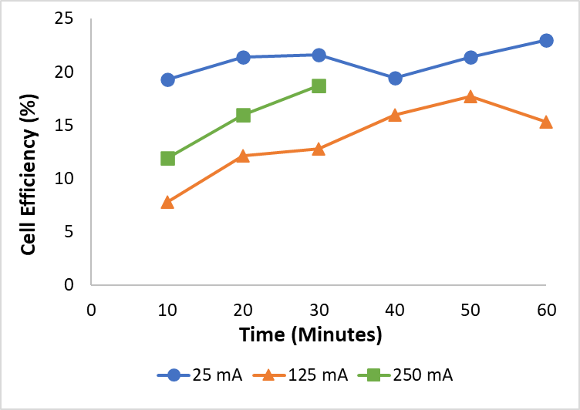
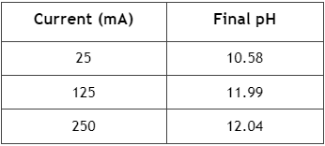
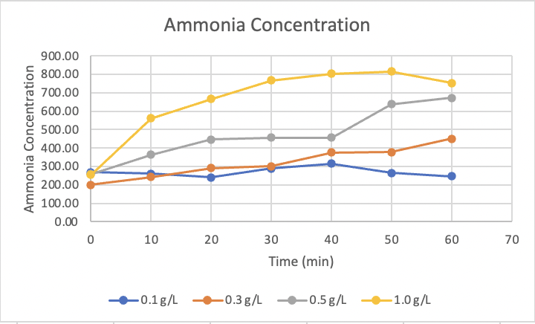
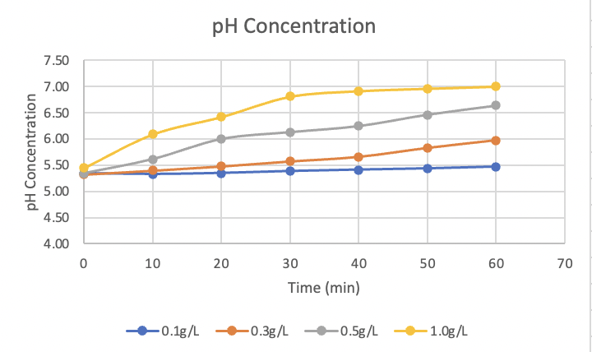
Electrochemical Technology For Extracting
Nitrogen From Urine
Emily Schwendemann, Coulter Friez, & Dr. Sudeep Popat
Introduction
Recovery and re-use of resources such as nitrogen and phosphorous are critical for long-term space missions. In this experiment, nitrogen was to be recovered from human urine, which, though initially in a recoverable form of urea, is hydrolyzed into the unrecoverable form of ammonia by the urease enzyme. This process was attempted to be inhibited by the study with the addition of hydrogen peroxide produced in an electrochemical cell. Two experiments were conducted: one on the concentration of urease in relation to ammonia production and another on the current effect on hydrogen peroxide production. The results show some bright potential for this method of recovery, although further research is required.
Electrochemical Cell
A chronopotentiometry galvanostat method was used to hold the working electrode at a specific current for 30 minutes to 1 hour to see how fast hydrogen peroxide was produced within a cell.
The electrochemical cell that was used was of dimensions 5cm by 5cm, and was tested at 3 different currents: 25mA, 125mA, and 250mA.
To determine how much hydrogen peroxide was produced, a dilution of sodium sulfate, deionized water, and titanium oxysulfate was scanned in a spectrophotometer reading at 405 nm.
Samples were taken every 10 minutes, starting at time 10 to the completion of the galvanostat reader.
The results seem to show that as the current increases, efficiency decreases.
The graph and table shown above depicts the efficiency and final pH of each of the tested currents.
Ammonia Concentration
60-minute trials testing the levels of ammonia within a sample of synthetic urine at 4 different concentrations: 0.1g/L, 0.3g/L, 0.5g/L, and 1g/L.
Samples were taken every 10 minutes with Hach TNT 832 Ammonia test kits, starting from time 0 to time 60.
The results seem to suggest that as the concentration of urease increases within the urine, the concentration of ammonia also increases.
These graphs show the average concentration of Ammonia and pH through the duration of the experiment
Acknowledgements
We would like to thank both Dr. Popat, as well as Brooke Covert for directing our research and NASA SC Space Grant for making this research experience possible.
Future Effort
The next steps of this project might include combining multiple steps of this process including, but not limited to, adding synthetic urine into the electrochemical cell in place of the sodium sulfate to determine how the hydrogen peroxide concentration differs due to the different solutions, or adding hydrogen peroxide at set amounts to the hydrolysis reaction to see how the production of ammonia differs with the addition of hydrogen peroxide.
References
Philip H. Arve and Sudeep C. Popat. ACS ES&T Engineering 2021 1 (12), 1642-1648. DOI: 10.1021/acsestengg.1c00194
Ray, H.; Saetta, D.; Boyer, T. H. Characterization of Urea Hydrolysis in Fresh Human Urine and Inhibition by Chemical Addition. Environmental Science: Water Research and Technology 2018, 4 (1), 87.
Udert, K. M.; Larsen, T. A.; Biebow, M.; Gujer, W. Urea Hydrolysis and Precipitation Dynamics in a Urine-Collecting System. Water Res. 2003, 37 (11), 2571.
Udert, K. M.; Larsen, T. A.; Gujer, W. Fate of Major Compounds in Source-Separated Urine. Water Sci. Technol. 2006, 54, 413.
Notes:
This page is set up as a custom page size: 36” x 36”
The layout illustrated above is an ‘example’. All boxes are placeholders to illustrate what you might do for your own project – feel free to change as needed to accommodate your research report. Feel free to use color etc to make your poster engaging and informative.
Please include figures and figure captions to support your research summary.
When complete – SAVE it with your LAST NAME-PASU2021 and post to the google link provided

