Slide 1
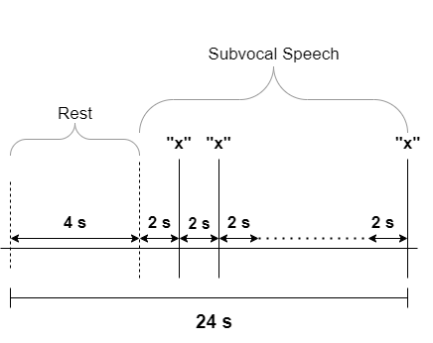
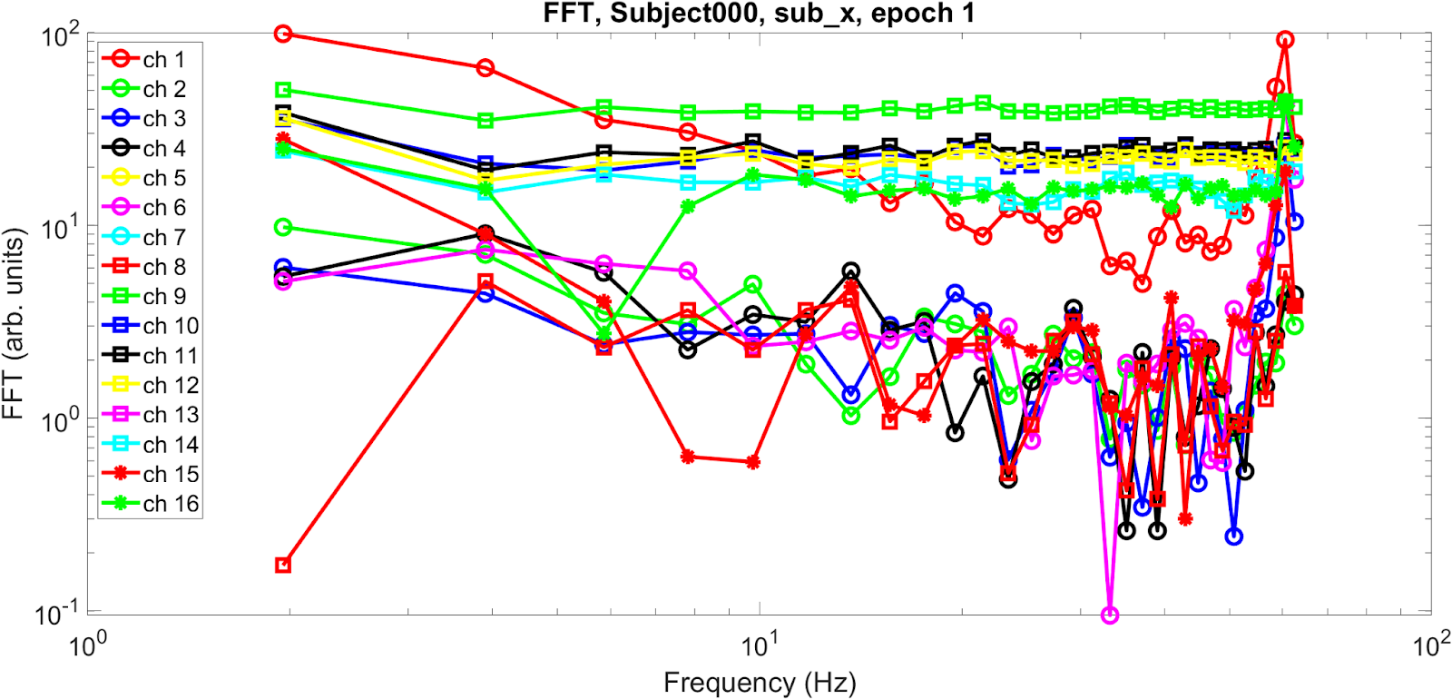
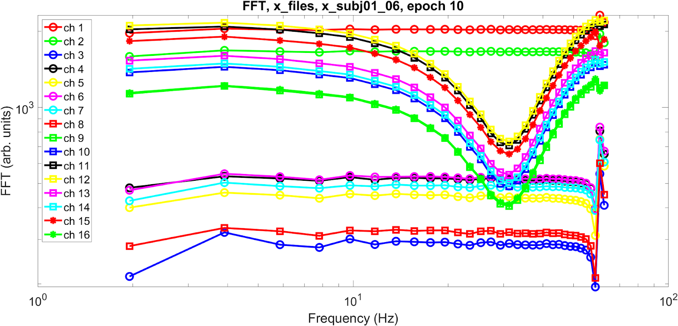
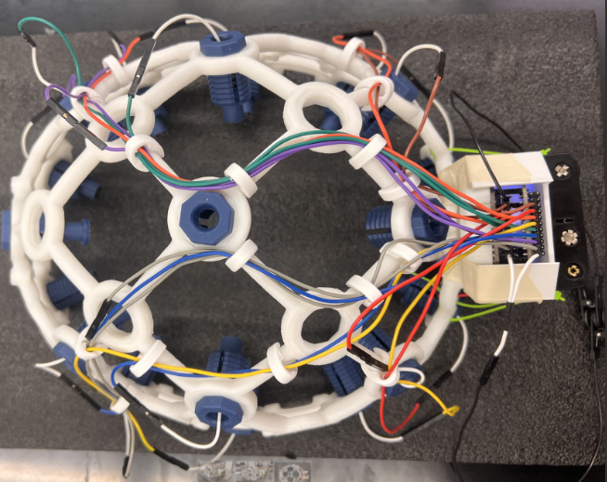
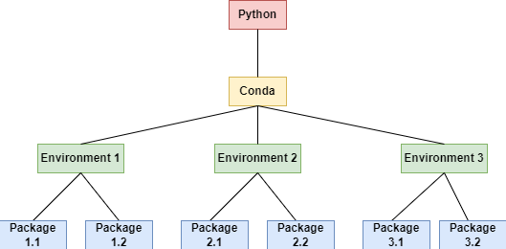
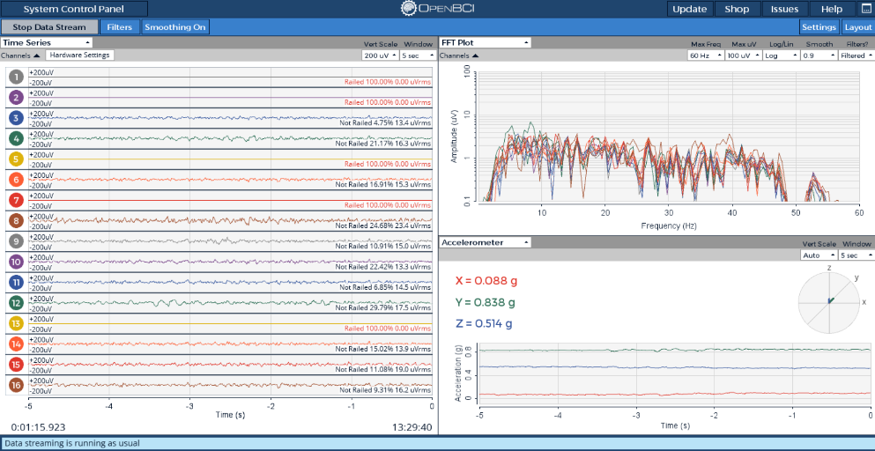
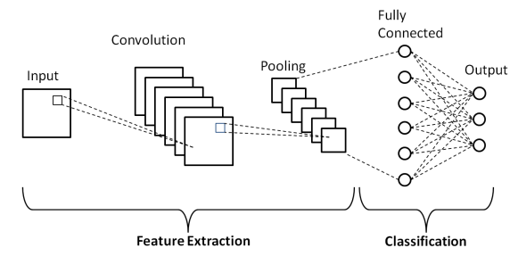
A Brain-Computer Interface for Subvocalization Tasks
Eric V. Beaver¹, Sorinel A. Oprisan²
¹Department of Computer Science, College of Charleston, Charleston, SC 29424 USA
²Physics and Astronomy Department, College of Charleston, Charleston, SC 29424 USA
Introduction
Figure 2: Visualization of Recording protocol for one epoch.
EEG Data
People that suffer from locked-in syndrome and ALS are unable to communicate with the external world. A brain-computer interface (BCI) that uses an electroencephalogram (EEG) could help such subjects. Subvocalization refers to talking in the mind without any audible noise or muscular activity. Subjects use subvocalization to communicate through a BCI that uses machine learning algorithms to classify the subject’s brain activity waves. Our goal was to verify and modify an existing algorithm that worked on one subject, expanding its capabilities for data recorded from multiple subjects.
a
BCI Hardware
EEG Synchronization
a
Our script synchronized the EEG recording with the behavioral protocol. The script would then run the protocol with the auditory beeps and play a different tone to signify the end of the recording.
b
Figure 1: (a) OpenBCI headset with 16 electrodes that was used. (b) User Interface of OpenBCI that shows a typical recording.
A 60 Hz notch filter, along with a bandpass filter of 5-50 Hz, was used for noise reduction.
Machine Learning Algorithm
Package management is critical since a virtual environment with multiple dependencies must be maintained correctly to communicate with the CUDA processors.
Figure 3: Visualization of virtual environments
Figure 5: (a) Fast Fourier Transform (FFT) of Subject000 during epoch 1 of “x” event. (b) FFT of data from the subject which the algorithm is known to work for during epoch 10 of the “x” event.
b
Conclusions
The data recorded from subjects showed almost no FFT structure (Fig.5a) compared to data recorded from a subject for which the algorithm works (Fig. 5b).
The synchronization of EEG recording with the subvocalization protocol was not perfect. We were forced to also record the time indexes at which beeps occurred so that time slicing for events was as accurate as possible. Time drifting was also observed.
Future efforts should investigate the headset to verify its ability to conduct high-quality recordings or use different devices.
Deep Learning Networks
EEG recordings were normalized, put into a 10x11 spatial matrix padded with zeros, and sliced at appropriate time indexes to create normalized 3D matrices representing the events of subvocal speech that served as input for the neural network.
Acknowledgments
Subvocalization Protocol
The subject was instructed to either think of “x” or “y” without the use of any muscles every time they heard an auditory beep. Each recording consisted of 10 epochs, with each epoch consisting of 4 seconds of rest and 10 beeps separated by 2 seconds. 50 epochs were recorded over 3 days for each subject.
A South Carolina Space Grant Consortium Palmetto Academy Grant supported this research. S.O. acknowledges a Research & Development grant and an MAYS grant from the College of Charleston.
Figure 4: A typical convolutional neural network, like the one employed.

