Slide 1
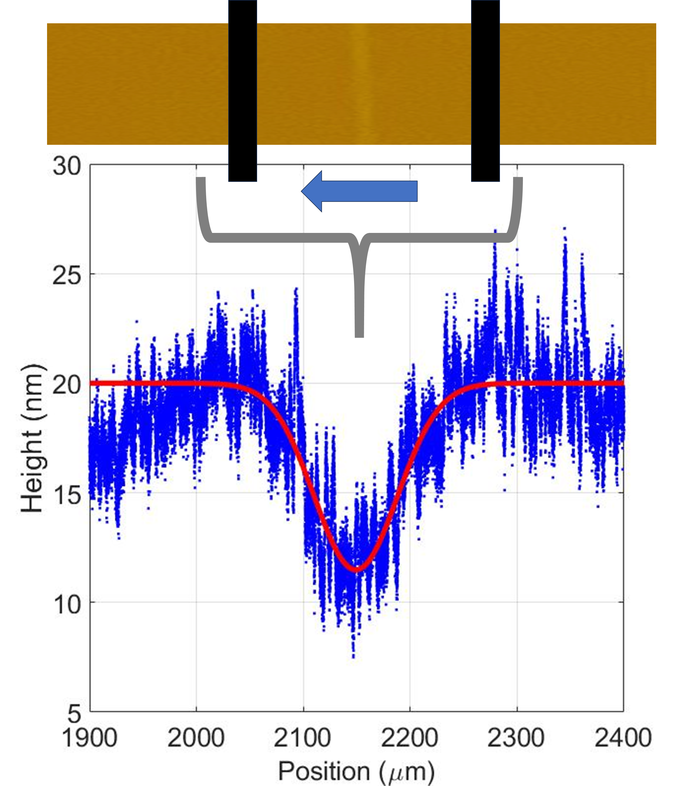
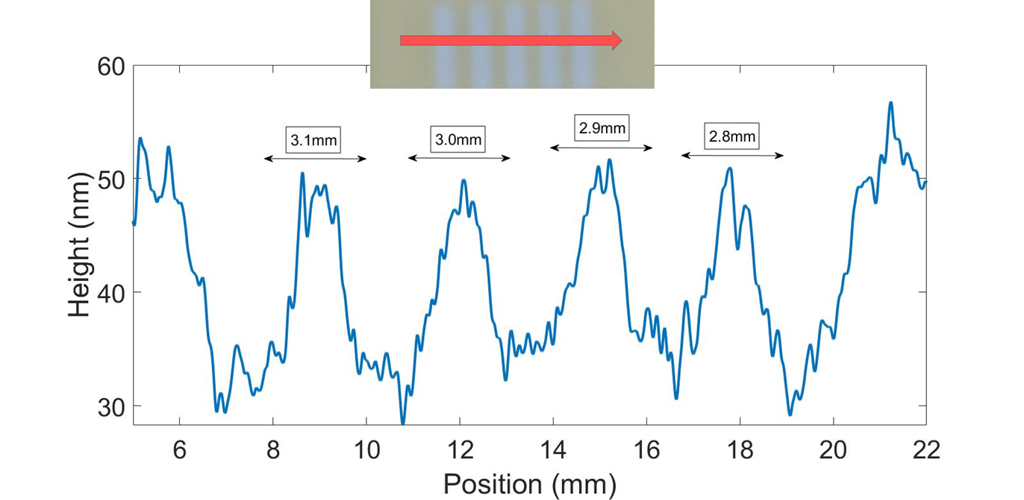
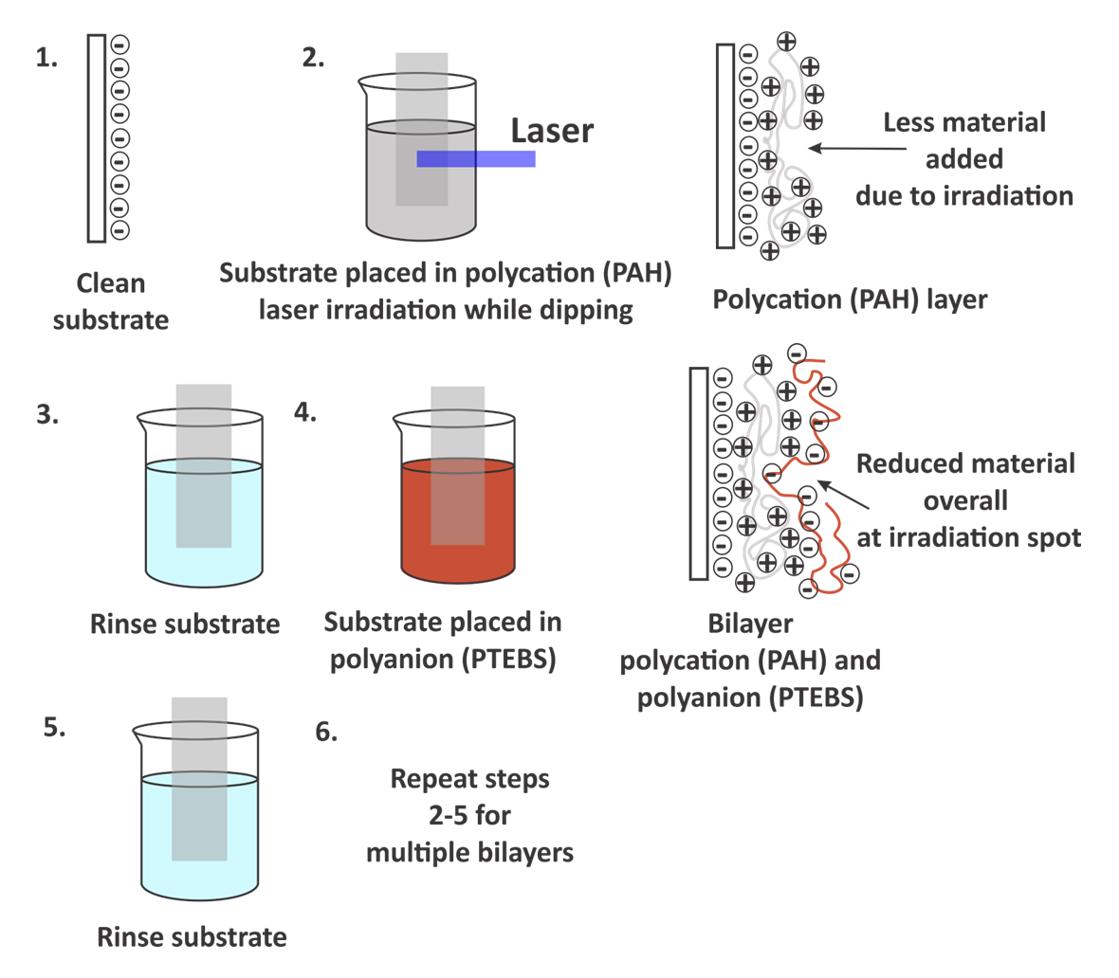
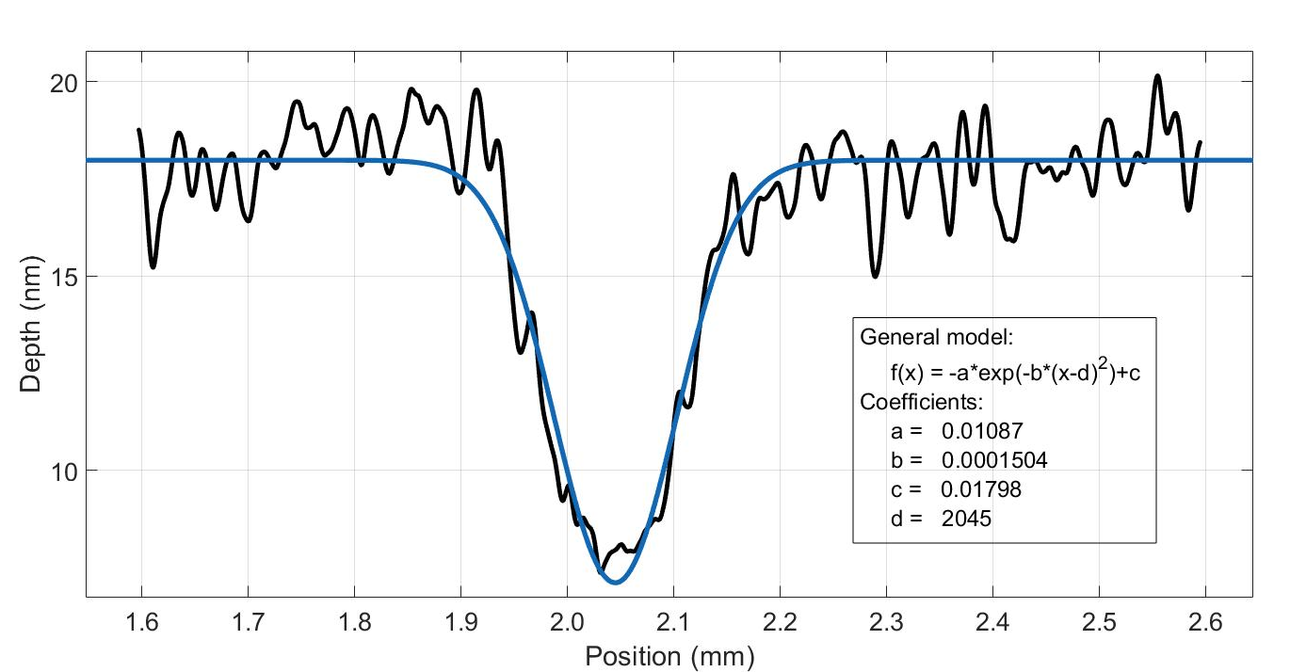
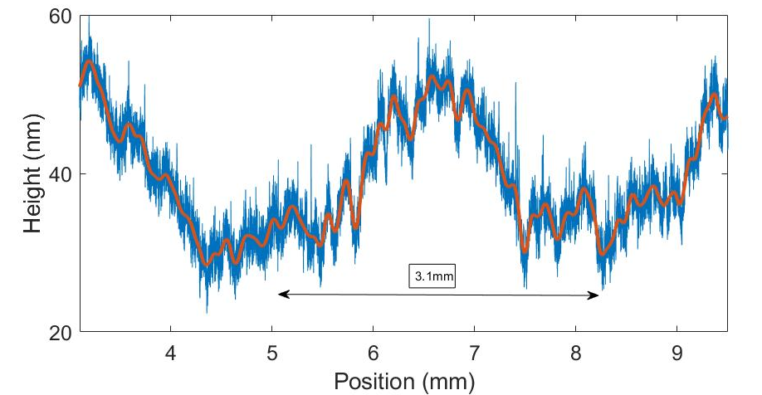
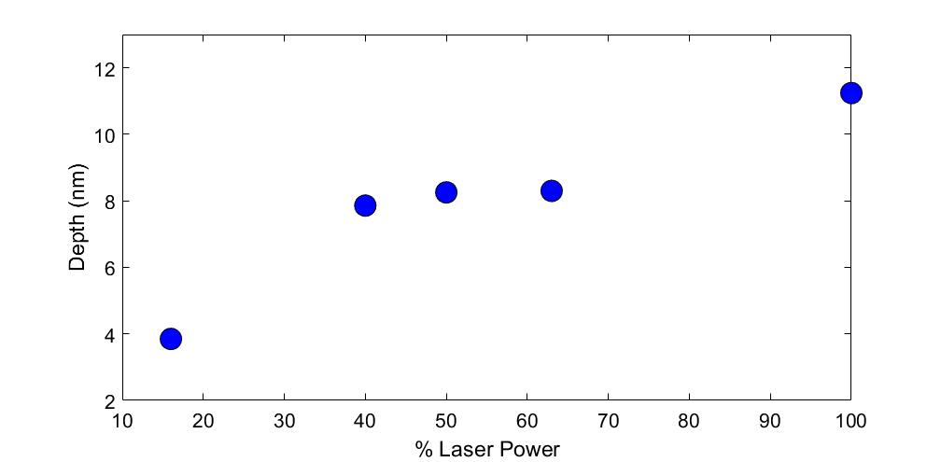
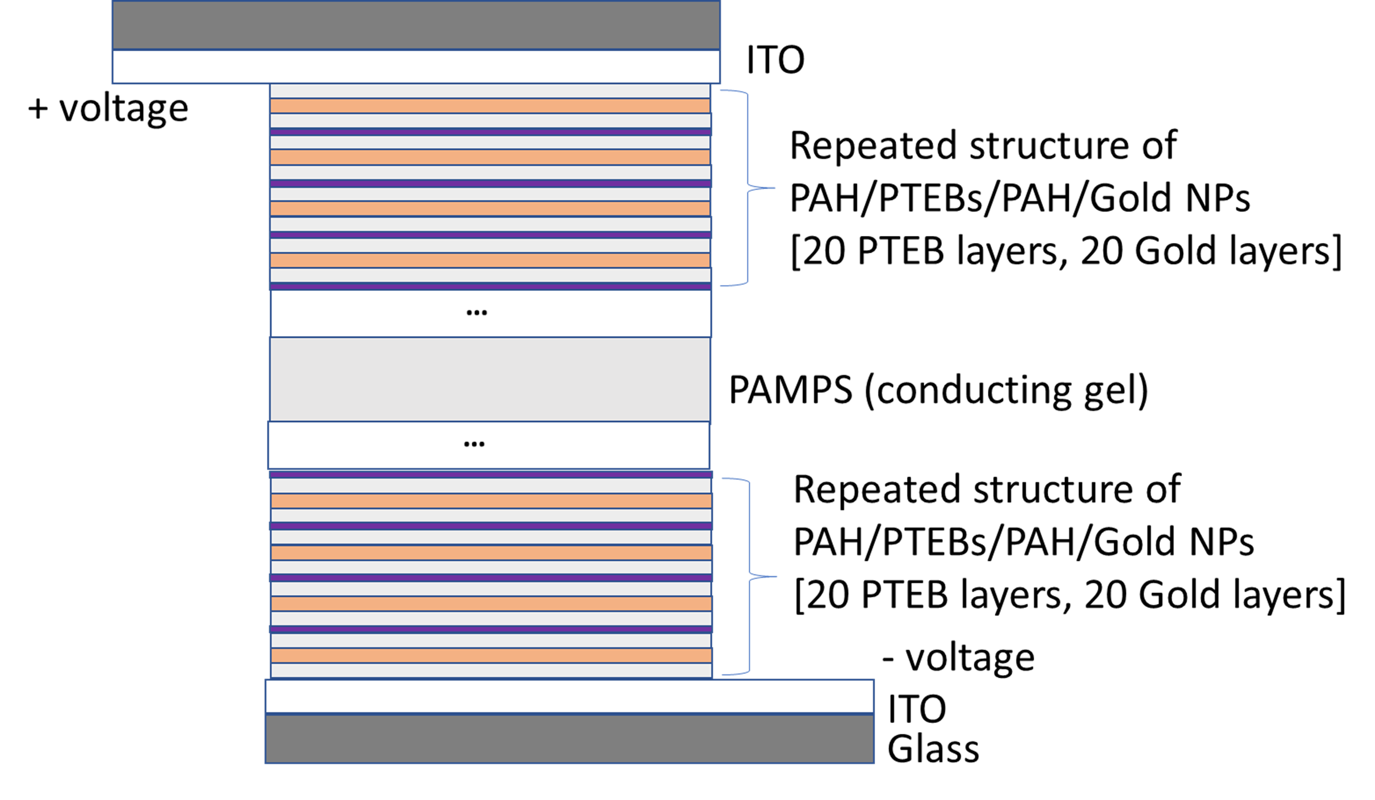
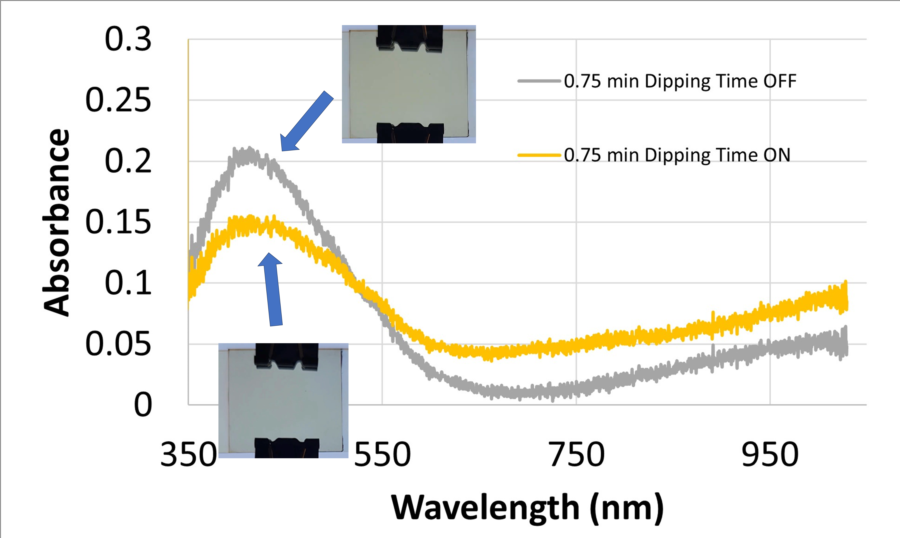
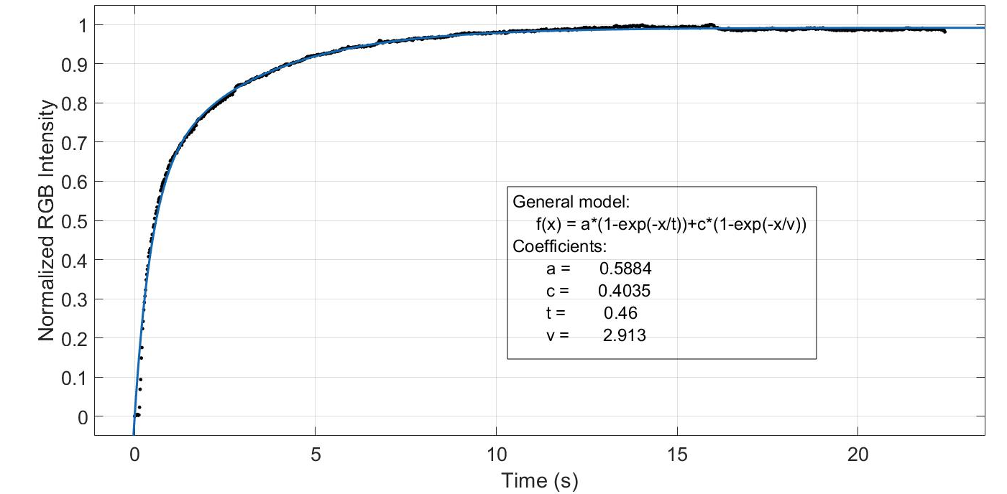
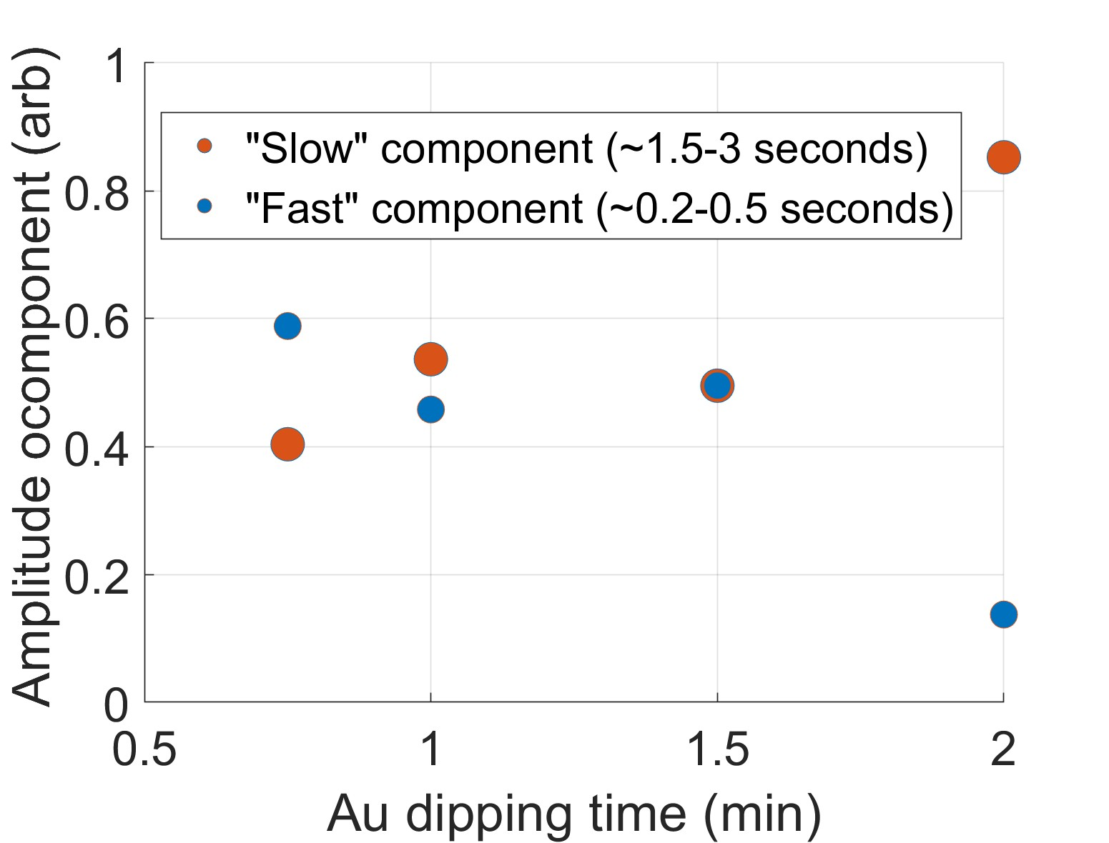
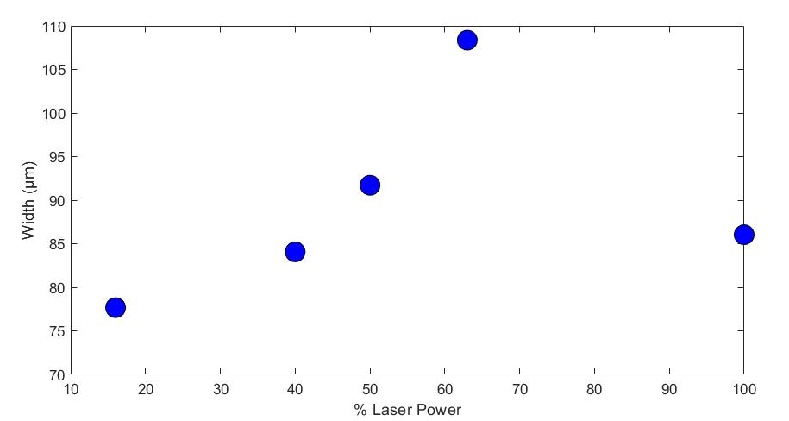
Sub-Millimeter Patterning and Inclusion of Gold Nanoparticles Using Layer-by-Layer Assembly
Jackson Wilhite¹, Kaelyn Leake², and Hank Yochum²
College of Charleston, Department of Physics
The Citadel, The Military College of South Carolina, Department of Physics
Introduction
Fabricating Sub-Millimeter Structures
Toward LmLBL Fabricated Waveguides
Advances in nano-scale fabrication techniques can lead to an increase in device design choices and functionalities for scientists and engineers to address challenges associated with space travel. Such advances in nanotechnology may lead to new approaches for sensors and instruments, for example, which are critical to the mission of NASA.
Our goal is to further develop the laser modified layer-by-layer (LmLBL) process to:
Fabricate sub-millimeter regions with specific refractive indices.
Investigate control of metal nanoparticle inclusion in patterned thin films.
200 bilayer PAH/PTEBs, single-lined He-Ne Laser, 100% Power.
Optical waveguides guide light effectively with low loss, are an example system that requires specific control over its geometry and material type.
50 bilayer PAH/PTEBs, 5-lined with semiconductor laser at 8% power.
Laser Modified Layer-by-Layer Assembly
All surfaces measured with KLA Alpha-Step D-500 profilometer.
Layer-by-layer assembly is done by dipping an electrically charged surface (such as a microscope slide) into alternating positively and negatively charged solutions.
Three solutions were used
A polycationic solution of PAH (Poly(allylamine hydrochloride) pH 3.5)
A polyanionic solution of PTEBS (Poly[2-(3-thienly)ethoxy-4-butylsulfonate] pH 3.0)
20nm diameter gold nanoparticle solution
Two main devices were investigated
PAH/PTEBS repeated bilayer structure
PAH/PTEBS/PAH/Gold NP repeated structure
Fitted sample depth as a function of position with Gaussian.
Resulting structure representing waveguide-like geometry.
Max depth (μm) = a
Width (μm) = $\sqrt{\frac{1}{b}}$
50 bilayer PAH/PTEBs, single line He-Ne laser, 100% power.
Electrochromic Devices with Gold Nanoparticles
Depth and width of patterned line for different samples with varying power.
LmLBL Robot Setup
Gold NP and PTEBS dipping time are equivalent.
This relationship between laser power and width suggest the inconsistency of using the He-Ne laser for sub-millimeter fabrication.
Laser options for patterning
He-Ne (633nm, 20mW, Gaussian beam)
Semiconductor laser (405nm, 0.5W, non-Gaussian beam)
The LmLBL robot also allows control of
# of bilayers
Irradiation time
Average power of the lasers
Dipping time
Fast amplitude = a
Fast lifetime = t
Slow amplitude = c
Slow lifetime = v
Contains two motorized stages that allow sub-micron control of the dipping position and position of the laser.
The stepper motor is responsible for positioning and rotation of the turntable.
Very low gold coverage on samples due to low pH of PAH.
Switching dynamics measured through RGB video analysis.
Conclusions
Low cost He-Ne laser successfully created submillimeter structures (sub-hundred micron by tens of nanometers).
He-Ne laser pattern is well described by a Gaussian which mimics laser beam profile.
The He-Ne laser pattern lacks precise repeatability of control over width.
The depth vs laser power plot gives an expected linear trend, but the width vs laser power plot gives a trend that is inconsistent with the expected results.
Inconsistency of the He-Ne laser control is due to many factors that affect sub-millimeter variability:
Positioning of beaker in beaker holder, turntable position controlled by stepper motor, background laser reflections
Successfully established the first steps in controlling the structure and geometry of a waveguide through LmLBL assembly
PAH/Gold NP samples fabricated (not shown) but significant gold coverage occurs only with high pH/cloudy PAH (cloudy PAH is a challenge for electrochromic devices.)
100% Power (0.5W) semiconductor laser could not pattern PAH/Gold NP sample.
There seems to be trends between dipping times and switching characteristics, but this is likely caused by PTEBS alone.
Cannot conclude that the gold nanoparticles affected the switching characteristics of the electrochromic devices.

