Slide 1
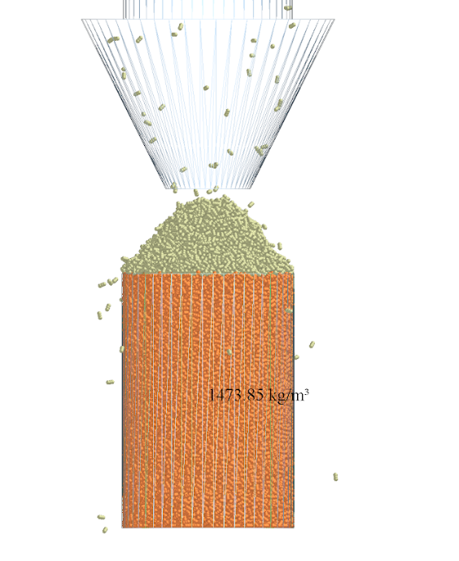
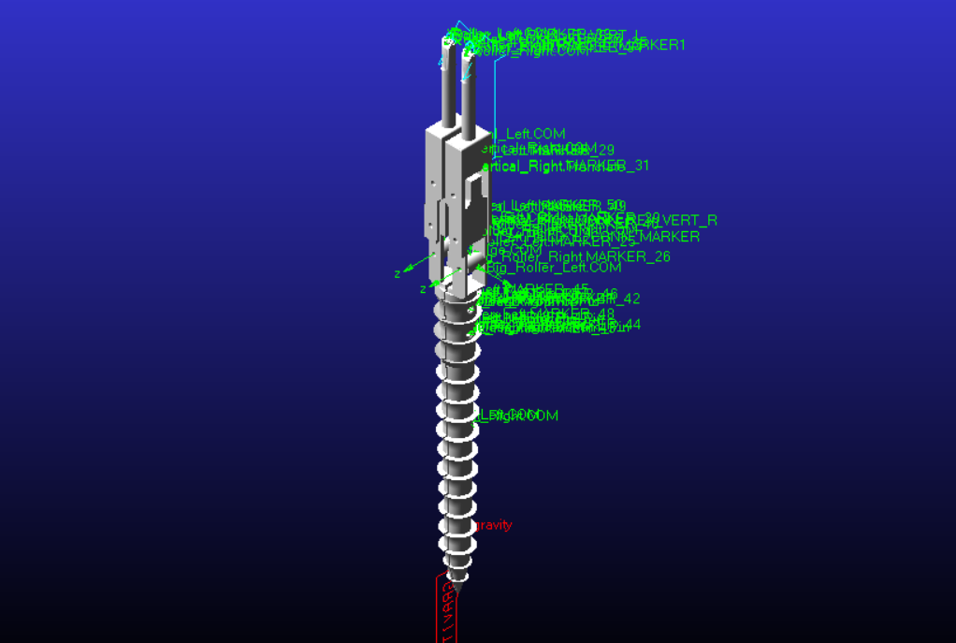
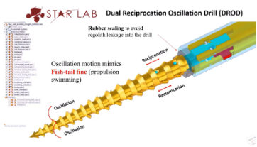
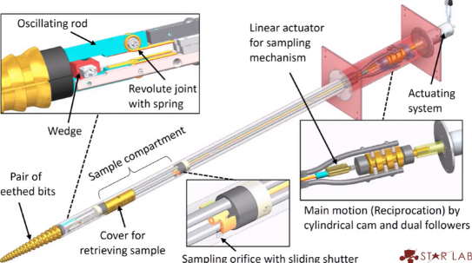
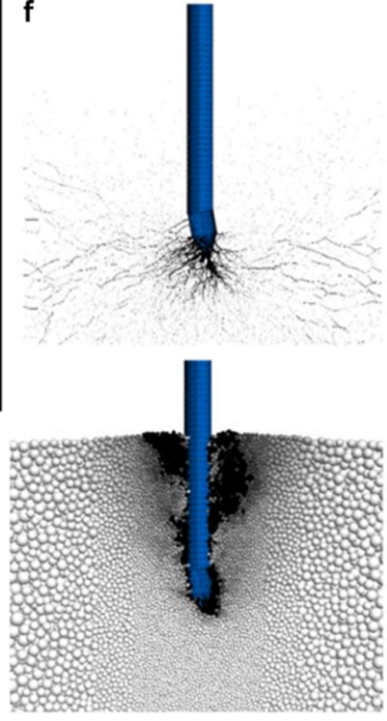
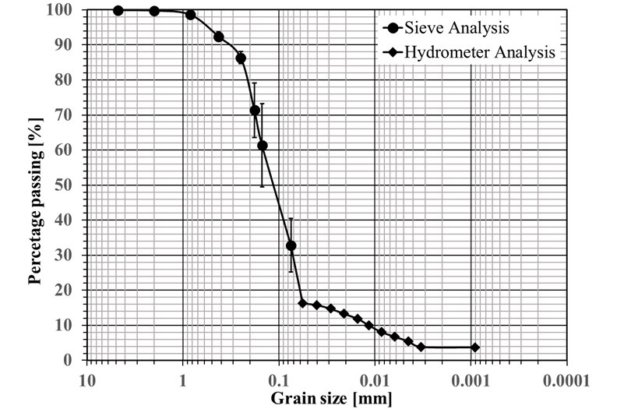
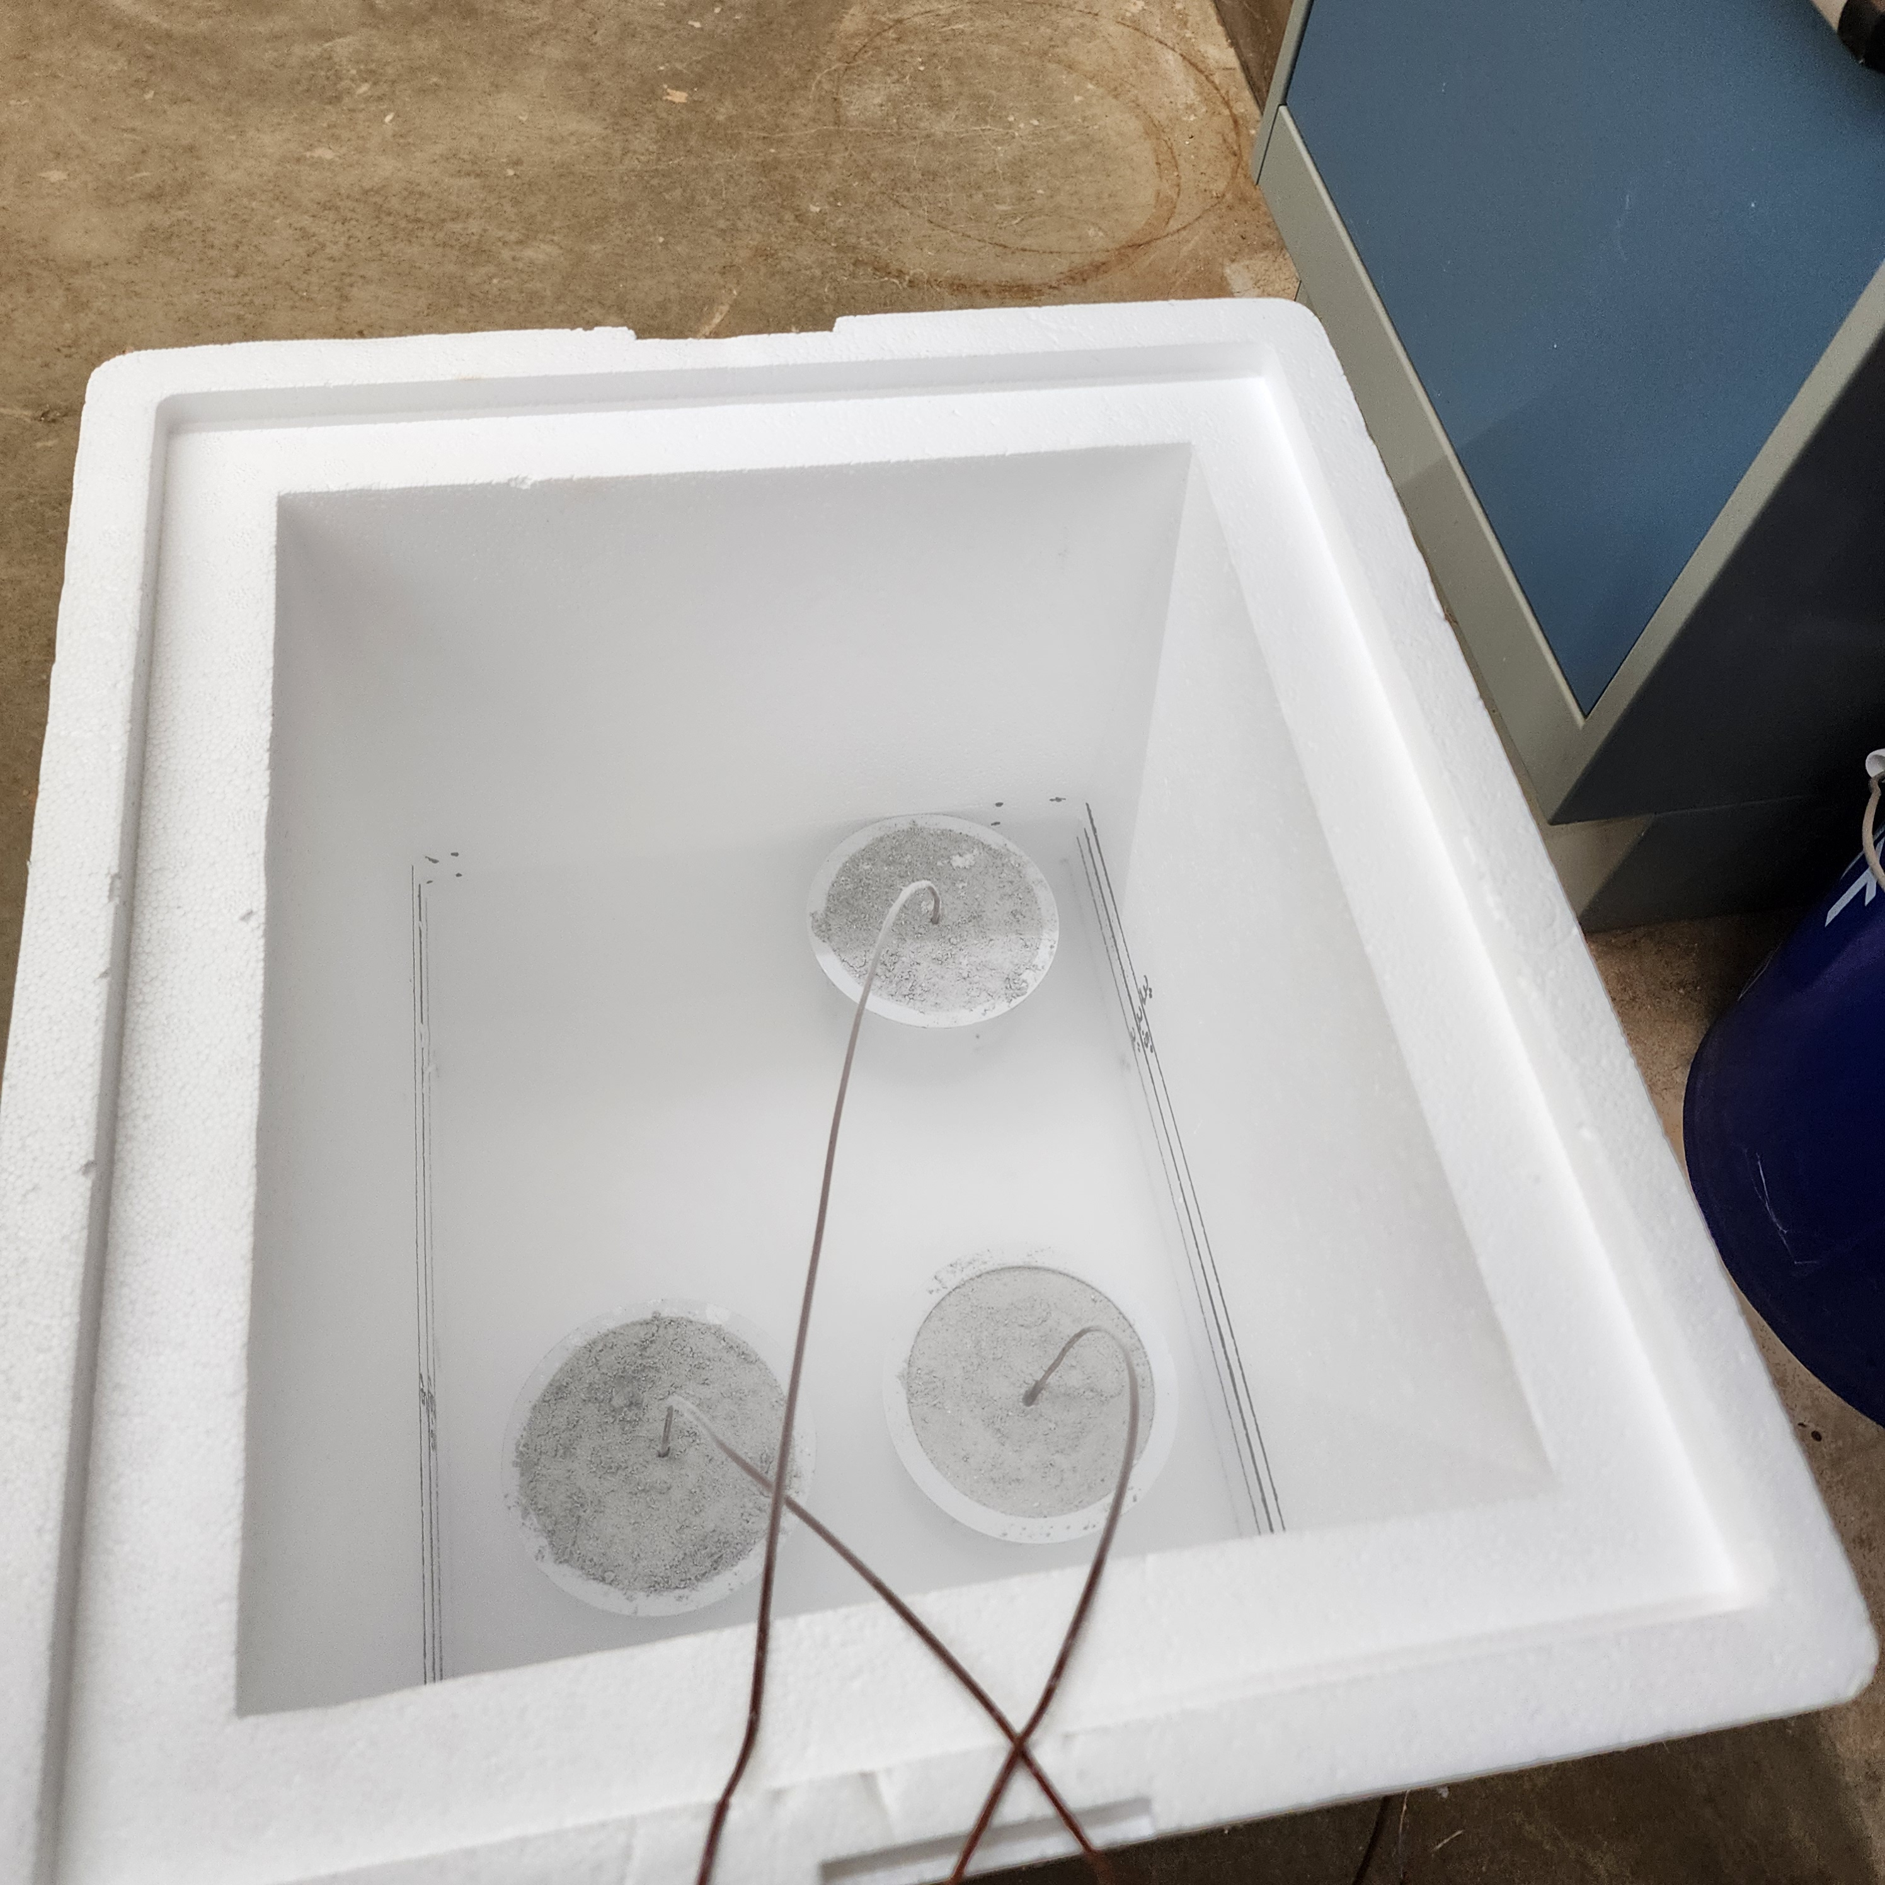
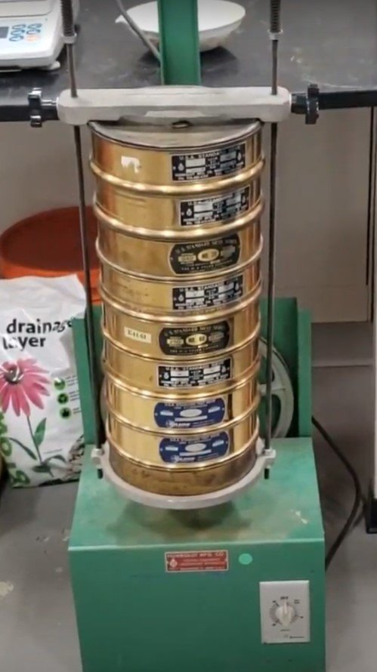
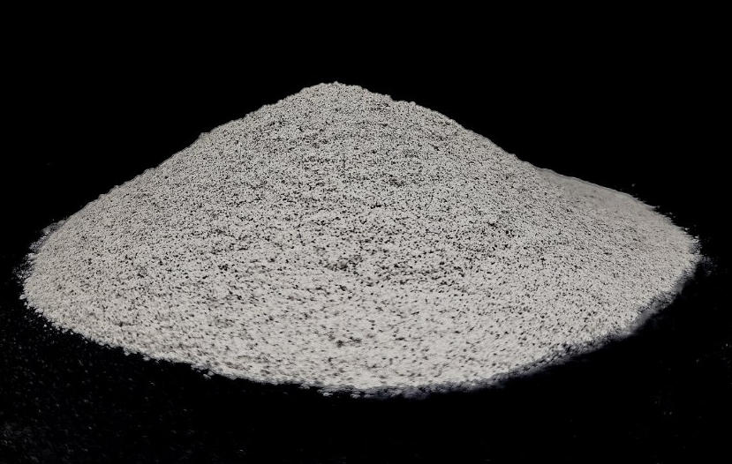
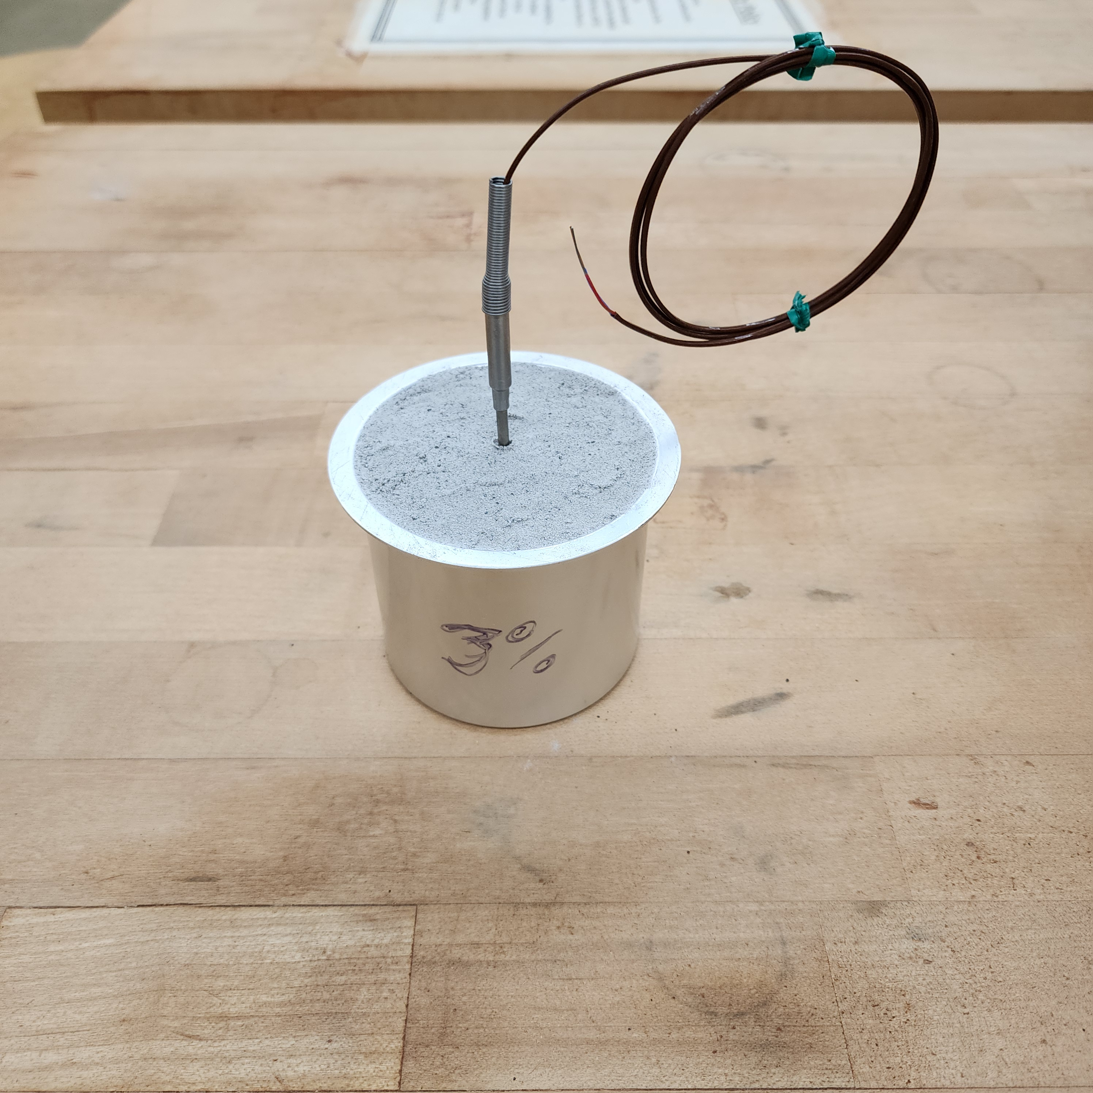
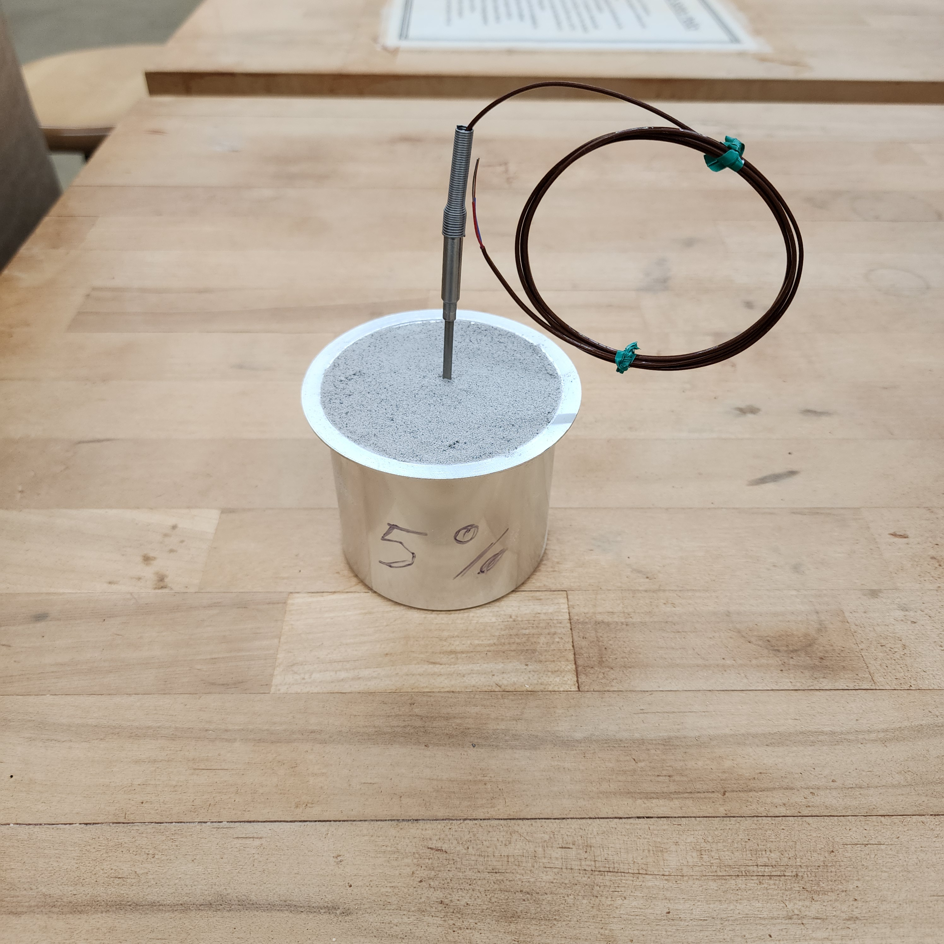
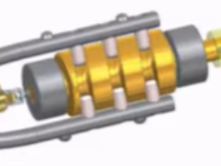
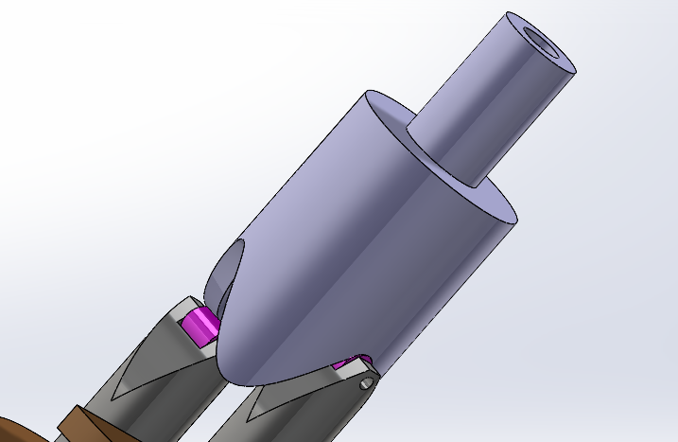
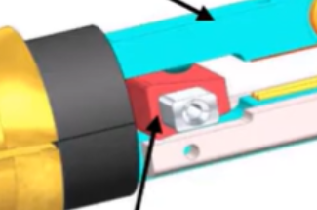
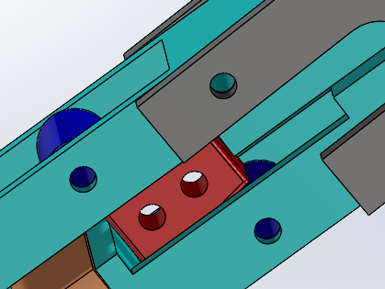
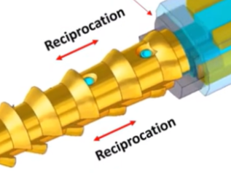
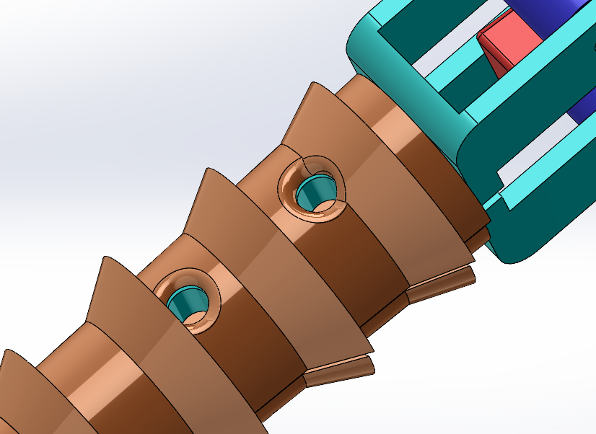
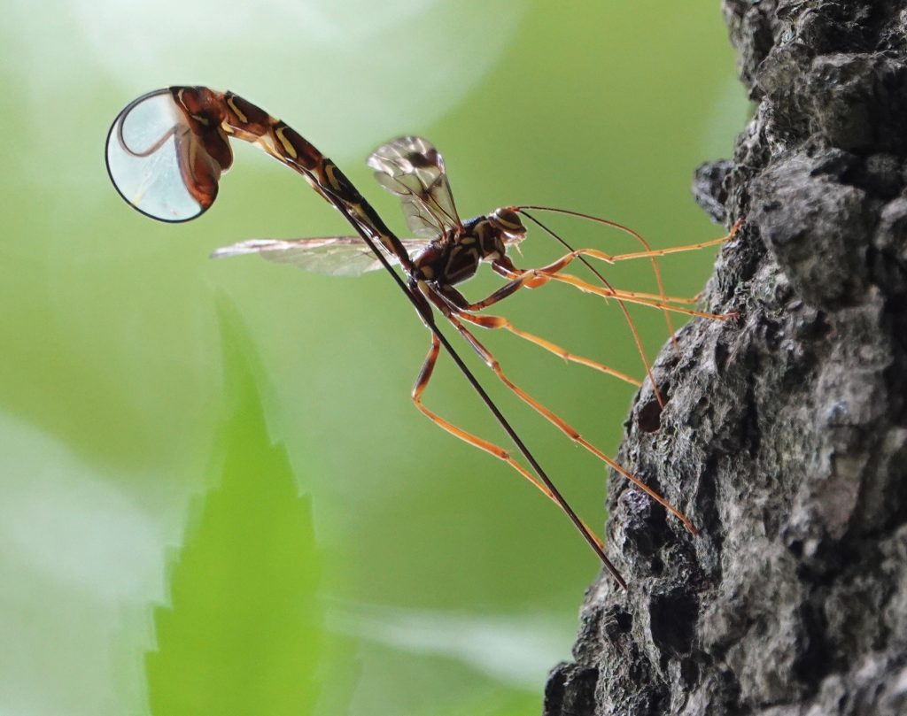
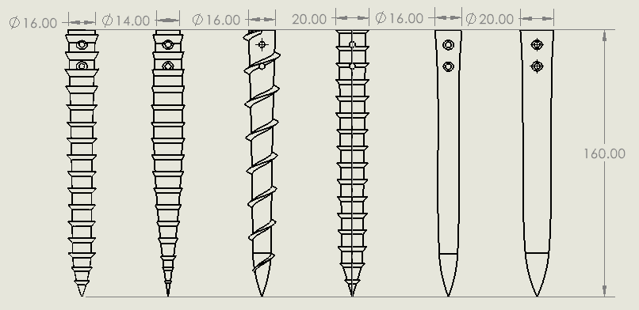
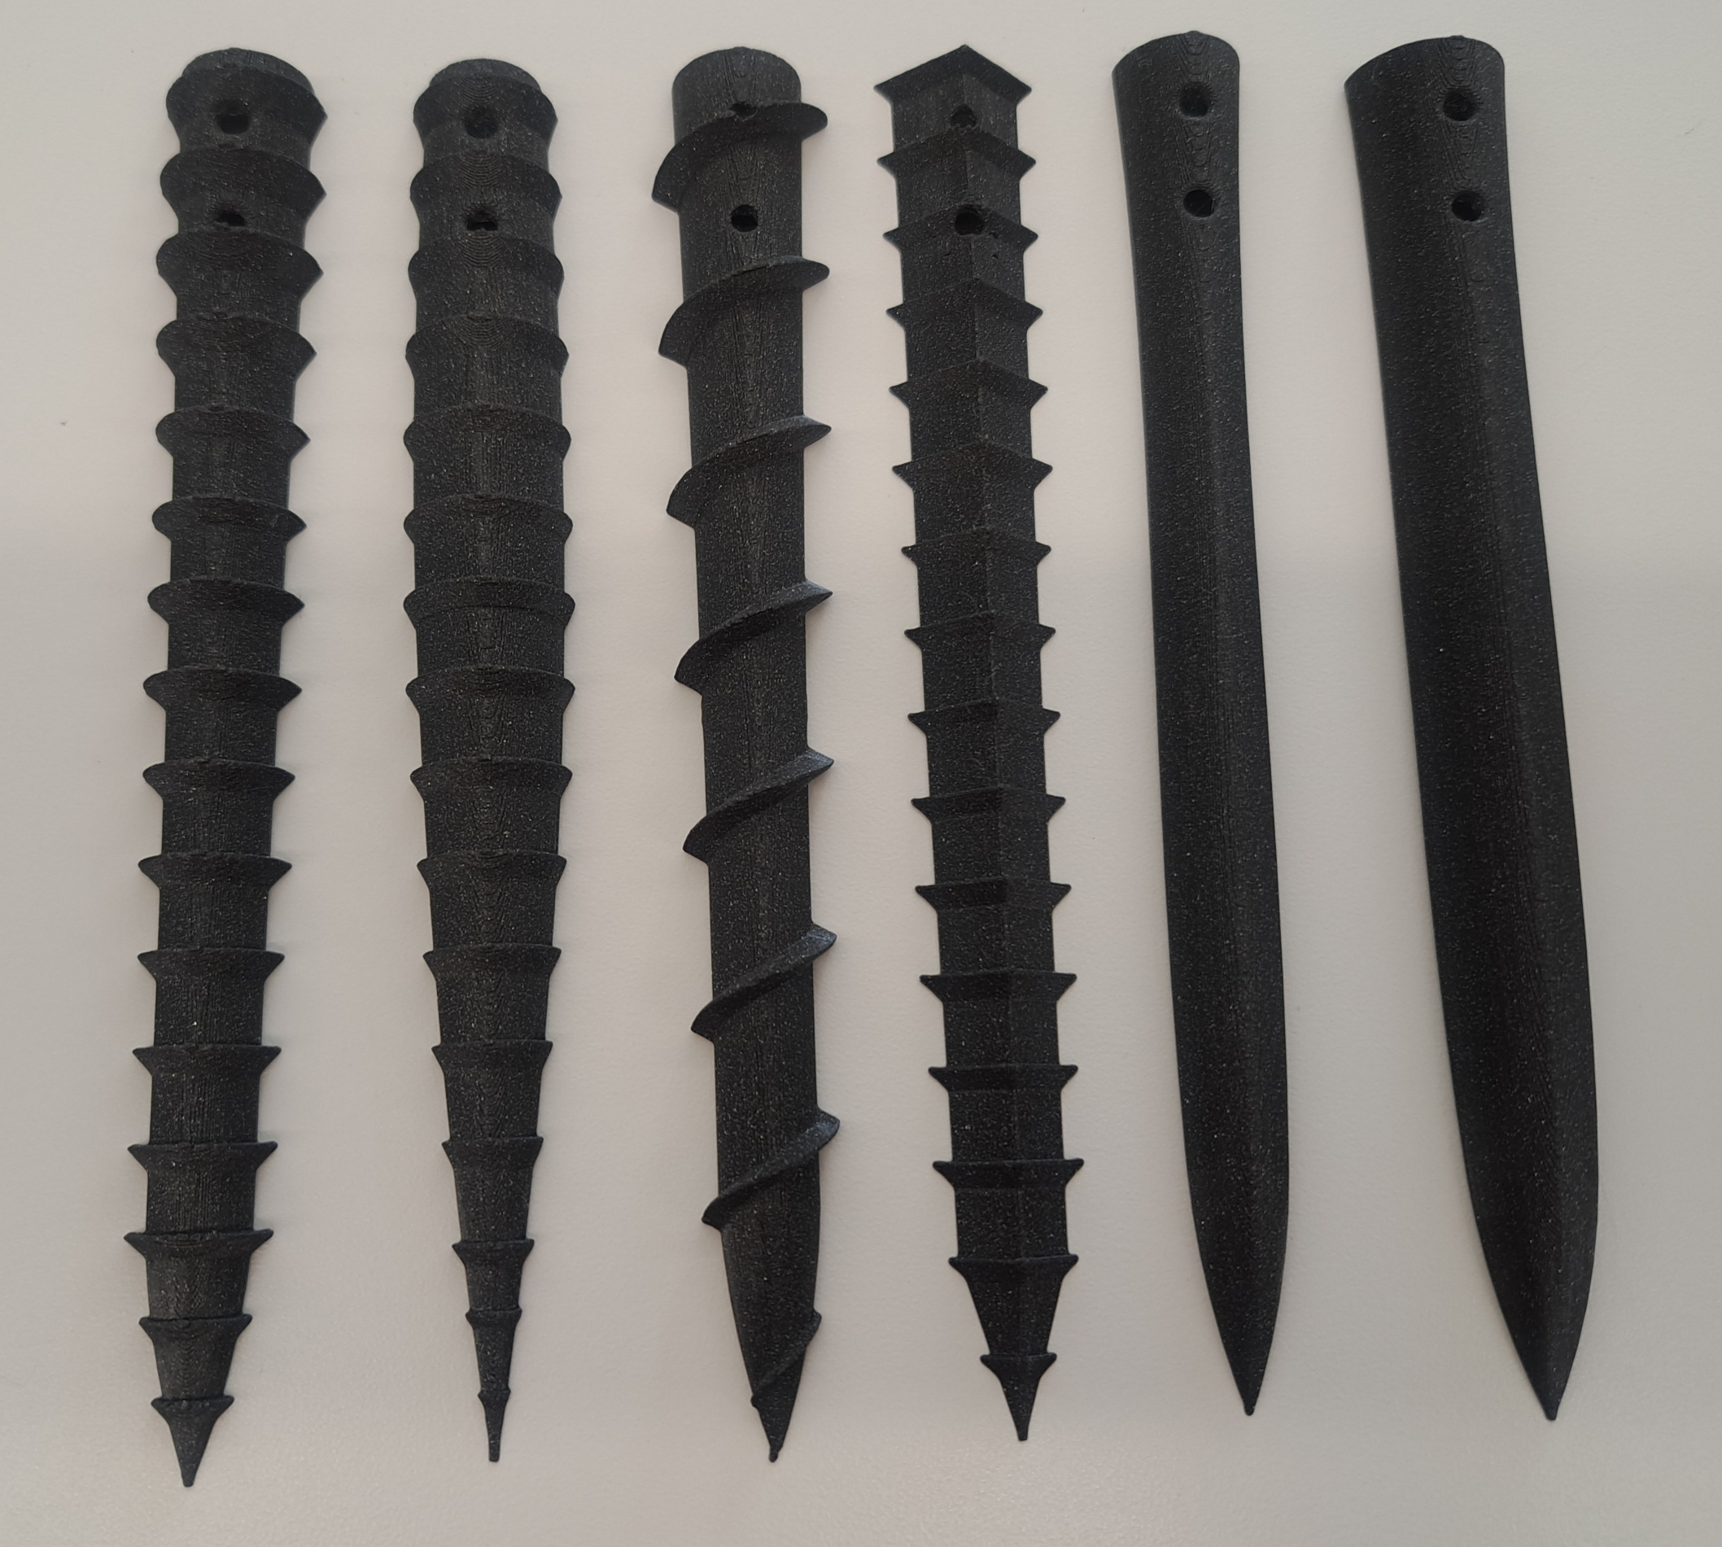
Bio-inspired Drilling into the Lunar Regolith
Presented by: Jasmine Hagerty¹, Zachary Smith², Alyssia Gaston³, Alexandra Davis⁴
Graduate Mentors: Jesus Badal, S.M. ASCE⁵, and Daniel Gaines S.M. ASCE⁵
Faculty Advisor: Qiushi Chen, Ph.D., A.M. ASCE⁵
¹Department of Mechanical Engineering, Clemson University; ²Department of Mechanical Engineering, Francis Marion University; ³Department of Mechanical Engineering, University of South Carolina; ⁴College of Science, Clemson University; ⁵Glenn Department of Civil Engineering, Clemson University
Dual Reciprocating Drill - Wood Wasp​
Overview
Dual-Reciprocating Drill
Craig Pitcher, Mohamed Ala, Xavier Pang, Yang Gao, Development of the Third Generation of the Dual-Reciprocating Drill, 5(3), Biomimetics, 2020. doi.org/10.3390/biomimetics5030038.
EDEM and ADAMS Modeling
NASA’s Artemis program is human-kind’s first attempt at establishing a permanent human presence on The Moon. For this to occur, it is necessary to be able to use resources from the lunar environment through in-situ resource utilization (ISRU). To exploit these resources, the Artemis Misson requires drills that can operate in the harsh lunar environment. Inspiration for this task came by researching how living organisms drill on Earth. In this study, research was conducted on designing a bio-inspired drill for ISRU efforts, specifically in the realm of drilling into icy lunar regolith. A wood-wasp inspired drill was designed using computer aided design (CAD) software, investigated using the capabilities of discrete element modeling (DEM) and multi-body dynamic software that simulated interactions between the drill and regolith. In addition, icy lunar regolith simulant beds were molded and prepared for experimental testing of the concept drill design.
Detailed design by the University of Surrey in the UK
Three different iterations of the drill
Basis for research conducted in this project
Lunar Highland Simulant 1 (LHS-1) calibrated using EDEM discrete element modeling
Common geotechnical tests performed include angle of repose and bulk density testing
ADAMS was used to simulate motion and interaction of the drill with the EDEM simulation
Data from software coupling shows how the drill will interact with regolith on the Moon
Craig Pitcher, Mohamed Alkalla, Xavier Pang, Yang Gao, Development of the Third Generation of the Dual-Reciprocating Drill, 5(3), Biomimetics, 2020. doi.org/10.3390/biomimetics5030038.
Drill designed and assembled in SolidWorks
3D printed and assembled to create a conceptual design
Bio-inspired Drilling
Experimental Set-Up
Root Growth Burrowing
Plant roots extend their tip into soil and excrete friction-reducing mucus cells
Detection stimuli allow for directional burrowing
Lateral hairs and branching systems act as anchors
The robots inspired by root growth use directional burrowing algorithms and an everting tip mechanism
Serve as an inspiration for the development of more efficient anchoring systems that model branching root shapes.
Thank you, Panda Express, for your chopstick contribution
Old Design
New Design
Modifications made to the Star Lab design reduce the number of small components that may possibly fail if deployed in the harsh lunar environment. These include:
Replacing the end cam with a barrel cam and springs to eliminate small pins and minimize shear forces
Increasing the size of the rollers
Allowing for greater ease of drill bit replacement
Laboratory tests for LHS-1 include specific gravity, particle size analysis, and tri-axial testing
Simulant oven-dried and moistened with 1, 3, 5, and 12 percent water content by mass and molded in aluminum containers (Dreyer et al. 2018)
Temperature probe inserted into the tops of the specimen to monitor the internal temperature of the regolith
Specimens placed in a freezer to pre-cool them to -20 °C before being transferred to a liquid nitrogen bath to reduce the temperature to -196 °C
Razor Clams - Self-Burrowing Out Robot (SBOR) ​
Two shell valves contract and expand to anchor and a fleshy foot that extends to burrow into the sand
The "foot" inflates as additional anchoring mechanism in downward motion.​
SBOR uses a fiber-reinforced silicone tube that mimics the opening and closing motion of a razor clam’s shell
The extension and contraction of the foot pulls the mechanism down​wards
https://doi.org/10.1115/CANEUS2006-11022
Summary
Research and design work was conducted to investigate NASA’s current lunar mission efforts and aid in progressing lunar drilling technology. The investigation included general bio-inspired drilling mechanisms with a specific focus on the design of a bio-inspired drilling mechanism based on the dual reciprocating methodology of a wood-wasp’s ovipositor. A DRD design by Star Labs was selected and modified to improve the serviceability of the drill concept and bit design. EDEM and ADAMS were used as a two-pronged approach of simulated drilling into the regolith to gather regarding the feasibility of the design in lunar applications. Physical specimens of icy regolith were created for testing of a prototype DRD drill. Research is on-going both in DEM simulations and laboratory experiments to test the drills in the icy regolith test bed and simulate the drill mechanism in a lunar environment via ADAMS.
Acknowledgment: This research was primarily supported by the NASA SC Space Grant Consortium under the federal award No. 80NSSC20M0054 and sub-award No. 521383-MS-CM-003. The research is also partially supported by sub-award No. 521383-PA-CM-012 and the NASA MUREP Institutional Research Opportunity Grant under Cooperative Agreement No. 80NSSC19M0196. The results and opinions expressed in this paper do not necessarily reflect the views and policies of NASA.
https://doi.org/10.1088/1748-3190/ab8754
Star Lab bit designs served as the inspiration for those created in this research project
Different bit profiles are better suited for different regolith types
Drill bit compatibility has been tested to determine the best geometry for various regolith grain sizes, textures, and locations.
Wood Wasp – Dual Reciprocating Drill
Wood wasps generate enough downward force to drill into wood despite their small size and the toughness of the material
Dual reciprocating drill (DRD) mechanism utilizes a bilateral reciprocating motion which requiring zero net insertion force and very little overhead force
Useful for locations with reduced gravity
https://besgroup.org/2022/01/11/parasitoid-wasp-3-drilling-with-ovipositor-that-is-3-to-4-times-its-body-length/
https://doi.org/10.1007/s11214-021-00863-2

